Slide 1
Welcome!
2025 New Mexico
ADA Coordinator Training
Certification Program
A partnership by
NM Governor’s Commission on Disability,
Southwest ADA Center,
and Great Plains ADA Center

Slide 2
Americans with Disabilities Act
Title I Employment Guidelines with
Emphasis on Reasonable Accommodations
Session: 1:45 to 4:45 pm MST
PRESENTER:
Julie Ballinger, Affiliate, Southwest ADA Center
505.797.8612 julieDballinger@outlook.com
The information herein is intended solely as informal guidance
and is neither a determination of legal rights or responsibilities
under the Act, nor binding on any agency with enforcement
responsibility under the ADA or any other law.

Slide 3
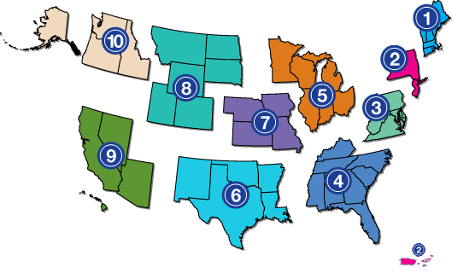
Southwest ADA Center
Expert staff are available to provide training, publications and respond to your inquiries.
Web Site: www.southwestADA.org
Hot Line: 1-800-949-4232
The Center is part of the ADA National Network funded by the National Institute on Disability, Independent Living, and Rehabilitation Research (NIDILRR) of the US Department of Health and Human Services.
The Leading Resource
ADA & other disability related laws
Serves a wide range of audiences
employers
businesses
government agencies
justice system
schools
nonprofits
people with disabilities

Slide 4
Handouts
Title I Employment Guidelines Presentation
Employee Accommodation Request Form EXAMPLE
Best Practices Regarding Medical Inquiries In Order To Determine Reasonable Accommodation
This session is being recorded and will be posted on the NM Governor’s Commission on Disability website.

Slide 5
Job Accommodation Network’s Workplace Accommodation Toolkit
Free online workplace accommodation toolkit provides employers with the tools needed to create a more
disability-inclusive and compliant workplace.
https://askjan.org/toolkit/index.cfm#
JAN homepage: www.askjan.org

Slide 6
Agenda
Title I – Employment components
Who is protected under the ADA
Important EEOC guidance documents
Three stages of employment & disability inquiries & confidentiality requirements
The reasonable accommodation (RA) process
Scenarios – applying ADA analyses as we learn
Determining an ADA issue
Interactive process
RA inquires
Satisfying the RA process requirements
Direct threat and RA
Reasonableness vs. undue hardship
Reassignment and leave as RA
Qualification, performance, and conduct standards
Additional EEOC guidance
What would you do? RA scenarios
Resources

Slide 7
Appendix
Types of RA
RA P&P Ingredients
Disaster Readiness Planning
Extensive Resources
ADA Technical Assistance Resources

Slide 8
Title I – Employment Components
Who is Protected Under the ADA
What Entities are Covered by the ADA
Employers with 15 or more employees (Private & Public)
(check for more stringent state/local laws)
No discrimination through contract
Disability Inquiries: Pre-Employment, Post Offer-Pre-Employment, Employment, and Medical Examinations
What Constitutes a Qualified Individual with a Disability
Essential and Marginal Job Functions and How They Relate to the ADA
Reasonable Accommodations (Application & Employment)
Undue Hardship
Direct Threat
Qualification, Performance and Conduct Standards

Slide 9
Definition of Disability - ADA Amendments Act Signed September 25, 2008 / Enacted January 1, 2009 / Regulations Effective May 24, 2011 Negates US Supreme Court Rulings that narrowed the definition of disability
The ADAAA retains without amendment the existing definition of the term “disability” but clarifies the key words and phrases in the definition. The term “disability” means, with respect to an individual
who has a physical or mental impairment that substantially limits one or more major life activities; or
has a record of such an impairment; or
is regarded as having such an impairment-even if he or she does not, in fact, have such an impairment (perceived) or the impairment it is minor.
Also covered are individuals who are discriminated against due to their association with a person with a disability.

Slide 10
ADAAA - Who is protected?
The definition of disability = broader coverage & major life activities now include bodily functions.
“Substantially limits” to be interpreted consistently with the ADAAA (rejects “prevent or severely restrict” = too demanding).
Substantially limits = only one major life activity has to be limited.
Episodic or in-remission impairments covered if substantially limits a major life activity when active.
Transitory and minor = not covered
Eliminates ‘mitigating measures’ test
Individuals who are otherwise qualified and can prove discrimination are entitled to relief.

Slide 11
For additional information and detail guidance on the ADAAA go to www.eeoc.gov
Questions and Answers on the Final Rule Implementing the ADA Amendments Act of 2008
www.eeoc.gov/laws/regulations/ada_qa_final_rule.cfm
Fact Sheet on the EEOC’s Final Regulations Implementing the ADAAA
www.eeoc.gov/laws/regulations/adaaa_fact_sheet.cfm
Final Regulations Implementing the ADAAA
www.federalregister.gov/articles/2011/03/25/2011-6056/regulations-to-implement-the-equal-employment-provisions-of-the-americans-with-disabilities-act-as
The ADA Amendments Act http://www.eeoc.gov/laws/statutes/adaaa.cfm

Slide 12
Take the time to read – it will pay off!
IMPORTANT
EEOC Technical Assistance Guidance
weblinks
throughout the presentation

Slide 13
Disability Inquiries / Medical Exams 3 Stages of Employment - Applies to ALL APPLICANTS & EMPLOYEES
Application
Disability-related questions and medical examinations are prohibited
What about agility tests for applicants?
There are “It depends questions”…will the particular question elicit information about disability?
About Affirmative Action Programs
EEOC ADA Enforcement Guidance:
Preemployment Disability-Related Questions and Medical Examinations
www.eeoc.gov/policy/docs/preemp.html
Don’t do another employment interview until you have read this!

Slide 14
Disability Inquiry Exceptions (1)
May ask if the employer reasonably believes:
the applicant will need RA because of an obvious disability, or
the applicant will need RA because of a hidden disability that the applicant has voluntarily disclosed, or
An applicant has voluntarily disclosed that they need RA to perform the job.
Notes:
Employer reasonably believes that an RA will be needed to perform essential functions - may ask if RA is needed and what type of RA

Slide 15
Disability Inquiry Exceptions (2)
When an employer reasonably believes that an applicant will NOT be able to do the job (or parts of the job) because of a known disability
May ask that particular applicant to describe or demonstrate how they would perform the function(s) with or without reasonable accommodations
“Known disability” is because it is obvious, or the applicant has voluntarily disclosed
Example next slide

Slide 16
Exception Example
An employer may ask an applicant, who is a wheelchair user, who applies for a job as a Plumber to explain or to demonstrate how, with or without RA, she would be able to transport herself and her tools down the basement stairs in private homes and businesses.
Can NOT ask why she uses a wheelchair or about any underlying medical condition
If the applicant says that she will need RA, the employer may ask questions about the type of required RA such as “What will you need?”
Notes:
NOTE: If the known disability of an applicant will NOT interfere with or prevent the performance of a job-related function, the employer may only request a description or demonstration by the applicant if it routinely makes such a request of all applicants in the same job category.

Slide 17
Disability Inquiries
Post Offer – Pre-Employment
An employer can ask disability-related questions, including need for RA, and do medical examinations.
All entering employees in the same job category must be subjected to the same examination/inquiry.
Medical information must be kept confidential and kept in a separate file from the regular personnel file.
Information shared as appropriate – more on this later
EEOC ADA Enforcement Guidance:
Preemployment Disability-Related Questions and Medical Examinations
www.eeoc.gov/policy/docs/preemp.html

Slide 18
Inquiries
Employment
Disability inquiries and medical exams can be made when it is
Job Related and Consistent with Business Necessity
an employee’s ability to perform essential job functions will be impaired by a medical condition/disability
an employee will pose a direct threat due to a medical condition/disability
Providing reasonable accommodation when the disability and/or need for Reasonable Accommodation is not obvious (more on this later)
EEOC ADA Enforcement Guidance: Disability-Related Inquiries & Medical Examinations of Employees Under the ADA
www.eeoc.gov/policy/docs/guidance-inquiries.html

Slide 19
Confidentiality Requirements
All information obtained regarding the medical condition or history of any employee (or applicant) when collected and maintained must be on separate forms and in separate medical files and be treated as a confidential medical record.
Exceptions:
Supervisors and managers may be informed regarding necessary restrictions on the work or duties of the employee and necessary accommodations;
First aid and safety personnel may be informed, when appropriate, only if the disability might require emergency treatment; and
Government officials investigating compliance shall be provided relevant information on request.
Note: The provision of reasonable accommodations is confidential and must not be shared with other employees – only share with those deemed appropriate.

Slide 20
Creating A Successful RA Process
Reasonable Accommodations
Always be formal =
officially sanctioned or recognized and documented
(does not mean complicated or difficult)
EEOC Enforcement Guidance on Reasonable Accommodation and Undue Hardship Under the ADA
www.eeoc.gov/policy/docs/accommodation.html

Slide 21
What is a Reasonable Accommodation?
According to the EEOC:
Any change in the work environment or in the way things are customarily done that enables an individual with a disability to enjoy equal employment opportunities
Equal employment opportunity to attain same level of performance or to enjoy equal benefits and privileges of employment

Slide 22
Why Reasonable Accommodations?
Societies are simply not built for those who function physically or emotionally, or cognitively differently from the vast majority of people.
These groups of people are less able to function in society due to attitudinal, architectural, educational, communicational, and economical (employment) & health care barriers.
Reasonable accommodation in employment is barrier removal and creates equal opportunity to succeed, be mediocre, or fail.

Slide 23
Reasonable Accommodation Scenarios Preview
What would you do?
Apply ADA analysis as we go through the training

Slide 24
Seizures (Preview)
An employee, whose job it is to market the firm’s services by meeting with potential clients at their offices, develops a condition that results in occasional seizures. As a result, the employee can no longer drive but wants to continue to do their job. The employee has worked for the firm for 15 years and has been recognized as the “best salesperson” 5 years in a row.

Slide 25
Developmental Disability (Preview)
A new restaurant manager visited one of the company's locations and observed that an employee with developmental disabilities was having a difficult time doing some of his work functions. When she questioned the employee, he responded that he is having a hard time because no one will listen to his mother. When the manager made inquires with the on-site supervisor about the situation, she was told that that the employee’s mother is really difficult to deal with and is always making demands, such as making sure to use visual aides when explaining work tasks and to put written instructions in larger text and an easy-to-read font. The supervisor added “I don’t have time to deal with the mother nor do what she is asking.”

Slide 26
Seasonal Affective Disorder (Preview)
A teacher with seasonal affective disorder requested a classroom with natural light and identified other issues that exacerbated her condition, including noise distractions and inadequate ventilation.
Although the school remedied most of these issues, it did not reassign her to a room with natural light.
As a result, the teacher needed to take medical leave.

Slide 27
Telework after COVID (Preview)
After COVID-related isolation subsided, the CEO of a large company required all employees to return to the workplace.
An employee with chronic migraines and fibromyalgia requested to continue working from home as an ADA reasonable accommodation, citing her ability to perform all essential job functions while telecommuting (which she successfully did during COVID).
Without discussing the request, the company denied it, stating that all employees must return as ordered. HR added that they were inundated with telecommuting requests and lacked the capacity to address them extensively. They also deemed her conditions "manageable" and episodic.

Slide 28
Chronic Fatigue Syndrome (Preview)
An employee, due to chronic fatigue syndrome, found it difficult to arrive at work on time early in the morning. For three years, the employee was given the accommodation of a later start time and received satisfactory job performance ratings all three years as a tax auditor.
A new supervisor decided that letting this employee come in later than the rest of the employees was bad for morale and that this employee could at least try to arrive at 8:00 am, so they removed the accommodation.
Plus, the new supervisor could not find any past documentation of the granted accommodation.

Slide 29
The ADA requires reasonable accommodation in three aspects of employment
1. To ensure equal opportunity in the application process
To enable a qualified individual with a disability to perform the essential functions of a job
A note regarding marginal functions elimination
3. To enable an employee with a disability to enjoy equal benefits and privileges of employment
Handout: Employee Accommodation Request Form EXAMPLE

Slide 30
Determining If You Have an ADA Issue Always do the analysis. Always stay with this order!
Relevant portions of the ADA require:
a covered employer;
to provide reasonable accommodation;
to otherwise qualified individuals;
with disabilities;
who are employees or applicants for employment;
to perform essential job functions or apply for a job;
unless to do so would cause undue hardship or is unreasonable.

Slide 31
For Each Employee Go Back to the Basics!
Does the individual have a Disability?
Is the individual otherwise Qualified?
Meets skill, experience, education & can perform the "essential functions" with or without reasonable accommodation
Does the accommodation Remove application or employment barriers?
Is the accommodation needed Reasonable or an Undue Hardship to do the essential job functions or to apply for the job?
Is the accommodation made being monitored to make sure it Remains Effective?

Slide 32
RA Interactive Process
According to EEOC guidance and case law, the ADA generally requires the employer and employee to engage in a flexible, cooperative, interactive process in order to identify a reasonable accommodation = Good Faith Effort.
The employer’s obligation to do so is normally triggered by an accommodation request.
Courts often rule in favor of the party who tried to engage in this process in good faith, and against the party who did not.

Slide 33
Getting The Interactive Process Started
RA Policies &Procedures
Make sure to include a process to monitor how accommodations are working and how leave as an RA interacts with FMLA
Individual must let employer know that an adjustment or change is needed for a disability/medical condition
Employer is not required to assume disability
Not obligated to observe an employee for any behavior that may be disability related, and then decide the employee is disabled

Slide 34
Getting the interactive process started (continued)
HOWEVER - the Request (No Magic Words) is the First Step in the interactive process between the individual and employer
Can be made by others (family member, friend) or by employer or other employee observation
Does not need to be in writing to start the process
NOTE: If employer knows RA is needed, even when employee does not identify or ask, then initiate – why? Because you know that you know…

Slide 35
Reasonable Accommodations Inquiries
The employer is entitled to know that an employee is covered under the ADA
When the disability or the need for the accommodation is NOT known or obvious
Can ask an employee for reasonable documentation about disability and its functional limitations as it relates to the reasonable accommodation and job
^{Example – next slide}
Handout: Best Practices Regarding Medical Inquiries In Order To Determine Reasonable Accommodations

Slide 36
RA Example
An employee who had COVID-19 and only experienced mild symptoms, is now experiencing bad headaches and intense light sensitivity to her office fluorescent lights, especially when the lights flicker. She requests that these lights be replaced with lighting that is more natural. This employee also makes it clear that indirect sunlight would be the best solution, so she wants to be moved to an office with windows that have light filtering shades.

Slide 37
Not Obvious And How Barrier Will Be Removed
Because this employee’s disability (bad headaches and light sensitivity) are not readily obvious, as well as how the requested RA is related to her disability, the employer may make disability-related inquiries and require the employee to provide, from her appropriate health care provider, disability documentation and how the RA request will remove the workplace barrier.

Slide 38
Medical Inquiries In Order To Determine Reasonable Accommodations
Employer can know enough about the disability/medical condition to know they are soliciting information from an Appropriate Professional (which is not always the PCP).
The employer can require the professional to have at least an adequate expertise in the employee's specific condition(s).
Can the employer know the diagnosis?
Get to know enough to know:
Covered under ADA? Is an appropriate professional?

Slide 39
Information Solicited Should Be Narrow In Scope
All the employer needs to learn from the professional is the following when the disability/medical condition or the need for the accommodation is NOT known and/or obvious.
Is the employee protected under the ADA?
When the manifestations or symptoms of the medical condition/disability comes into contact with the job’s essential function(s) WHAT BARRIERS are created?

Slide 40
Interactive Process (including medical information)
What is the duration of the impairment?
What specific disability symptoms/manifestations happen that affect doing the job?
What essential functions are involved?
As a result, what are the particular barriers that are created?
What barrier removal (reasonable accommodation) suggested solutions can be implemented?
Periodic follow-up to assure the accommodation effectiveness
(don’t forget about elimination of marginal functions)

Slide 41
Let The Professional Know
That, if at all possible, solutions should allow the employee to do the job. Solutions that will fundamentally alter the job should be of last resort.
If a leave of absence is required, would it be continuous and/or intermittent (specify when and estimate how long leave will be needed).
Do NOT ask for unrelated documentation!

Slide 42
As EEOC phrases it: Documentation is sufficient if it
describes the nature, severity, and duration of the employee's impairment, the activity or activities that the impairment limits, and the extent to which the impairment limits the employee's ability to perform the activity or activities; and,
substantiates why the requested reasonable accommodation is needed.

Slide 43
What Satisfies Accommodation Requirements?
Don’t have to give accommodation requested by employee* but the
Accommodation must be EFFECTIVE
must enable the employee to perform the essential functions of the job;
must enable applicant with a disability to have an equal opportunity to participate in the application process; and
must enable employee to enjoy privileges and benefits of employment
*If more than one RA is effective, the preference of the individual with a disability should be given primary consideration.

Slide 44
Steps - Reasonable Accommodation Interactive Process
Individual is covered by the ADA
Need for barrier removal related to disability
Medical documentation, if not obvious
Identify the barriers
Find and implement RA solutions
Monitored the RA to make sure it remains effective
Stay with the process / watch the knee-jerk reactions
= Lean Clean RA Machine

Slide 45
Direct Threat & Reasonable Accommodations
If an individual poses a Direct Threat
significant risk of substantial harm to the health and safety of the individual or others
the employer must determine whether a reasonable accommodation would either eliminate or reduce the risk to where substantial harm no longer exists
COVID issues – see EEOC COVID Guidance – Slide 54

Slide 46
Reasonableness & Undue Hardship
In US Airways, Inc. v. Barnett, 535 U.S. 391 (2002), the Supreme Court declared that the reasonable accommodation and undue hardship concepts are distinct. Under Barnett, the plaintiff bears the burden of showing that the accommodation is reasonable on its face , that is, ordinarily or in the run of cases. After that, the employer bears the burden of showing “special (typically case-specific) circumstances that demonstrate undue hardship in the particular circumstances.”
In US Airways, Inc. v. Barnett, the Supreme Court held that it was unreasonable, absent "special circumstances," for an employer to provide a reassignment that conflicts with the terms of a seniority system.

Slide 47
“UN”Reasonable Accommodation Examples
Eliminating essential functions of the job
Exception -- Note about “group” essential functions
Lowering production standards
Personal use items (i.e.: prosthetic limb, eyeglasses, hearing aids, wheelchair)
Placing a disabled applicant in job for which he/she did not specifically apply
Placing a disabled individual into a job if doing so would create a direct threat to the health or safety of the individual or others (risk cannot be lowered to acceptable level with reasonable accommodation)
Maintaining the salary of an employee reassigned from a higher-paying job to a lower-paying one if the employer does not do so for non-disabled.
Creating a job
Generally-reassignment violating a consistent uniformly applied seniority system
Bumping another employee from his/her job
Changing to a new supervisor
Medication monitoring

Slide 48
Undue Hardship = Formal Process
An employer does not have to provide a reasonable accommodation that would cause an "undue hardship".
Significant difficulty (includes disruptive) or expense and includes fundamentally alters the job.
Generalized conclusions will not suffice to support a claim of undue hardship.
Instead, undue hardship must be based on an individualized assessment of current circumstances that show that a specific reasonable accommodation would cause significant difficulty or expense.

Slide 49
Determining Undue Hardship Formal Process
The employer is the one who is required to show that an accommodation is an undue hardship.
Must consider whether there is an alternative accommodation that would not impose such hardship
Employers must determine undue hardship on a case-by-case basis
Consider the undue hardship in relation to the size of the employer
Resources available, and the nature of the operation
Factor in the effect of tax incentives (businesses) on the cost of an accommodation before making an undue hardship determination
Assessment of undue hardship is an ongoing process as resources and as situations change

Slide 50
Reassignment as Reasonable Accommodation Last Resort
Generally, do not have to permanently excuse “essential” job functions -if no accommodation that would allow performing those functions employer must consider reassigning to vacant position
Reassignment need not be promotion
Reassignment generally doesn’t require bumping
Parties should work together to identify vacant positions
Reassignment and a seniority system (if any other exceptions are made then must consider exception to meet RA)

Slide 51
Reassignment
EEOC and case law say actual placement required, not just allowing employee to compete.
Circuit majority rule now: Second, Seventh, and Eighth originally ruled must compete but the Seventh changed its ruling and the Eighth then relied on the Seventh and the Tenth ruled no compete
Before reassignment – dealing with “group” essential functions?

Slide 52
Leave As a Reasonable Accommodation
Can be one of the most important accommodations
Generally reasonable, but details may = “undue hardship” defense
Fact-specific defense based on individualized assessment
Allow use of leave benefits first (AL, SL, Long/Short Term Disability) and then generally unpaid - Unless pay provided to others like under a collective bargaining agreement
Leave as a RA must be considered in addition to FMLA leave, if necessary, BUT the employer, in evaluating undue hardship may consider the impact caused by the initial 12-week absence along with the undue hardship factors specified in the ADA. Open-ended leave is usually unreasonable.
EEOC - Employer-Provided Leave and the ADA
www.eeoc.gov/eeoc/publications/ada-leave.cfm

Slide 53
Qualification, Performance & Conduct Standards
Qualification / Performance must be:
Job related and consistent with business necessity
The qualification standards that are:
truly reflected in what is expected,
performed in the actual workplace and
based on essential job functions only (not marginal functions).
Conduct Standards
unacceptable workplace conduct can be enforced, even if due to disability – make sure to read the following guide
EEOC Guidance: The Americans With Disabilities Act: Applying Performance And Conduct Standards To Employees With Disabilities www.eeoc.gov/facts/performance-conduct.html

Slide 54
Additional EEOC Publications
What You Should Know About COVID-19 and the ADA, the Rehabilitation Act, and Other EEOC Laws
Check for periodic updates
Disability Discrimination and Reasonable Accommodation: Medical Inquiries, Leave and Telework
Nov. 2021 publication - includes court cases

Slide 55
Reasonable Accommodation Scenarios
What would you do?

Slide 56
Remember – stay with the ADA analysis
a covered employer;
to provide reasonable accommodation;
to otherwise qualified individuals;
with disabilities;
who are employees or applicants for employment;
to perform essential job functions or apply for a job;
unless to do so would cause undue hardship or is unreasonable

Slide 57
Seizures
An employee, whose job it is to market the firm’s services by meeting with potential clients at their offices, develops a condition that results in occasional seizures. As a result, the employee can no longer drive but wants to continue to do their job. The employee has worked for the firm for 15 years and has been recognized as the “best salesperson” 5 years in a row.
Outstanding Issue?
Essential functions vs. marginal functions

Slide 58
Developmental Disability
A new restaurant manager visited one of the company's locations and observed that an employee with developmental disabilities was having a difficult time doing some of his work functions. When she questioned the employee, he responded that he is having a hard time because no one will listen to his mother. When the manager made inquires with the on-site supervisor about the situation, she was told that that the employee’s mother is really difficult to deal with and is always making demands, such as making sure to use visual aides when explaining work tasks and to put written instructions in larger text and an easy-to-read font. The supervisor added “I don’t have time to deal with the mother nor do what she is asking.”
Outstanding Issues?
RA can be requested by a third party
The lack of the interactive process
Formally determining if an undue hardship exists

Slide 59
Seasonal Affective Disorder
A teacher with seasonal affective disorder requested a classroom with natural light and identified other issues that exacerbated her condition, including noise distractions and inadequate ventilation. Although the school remedied most of these issues, it did not reassign her to a room with natural light. As a result, the teacher needed to take medical leave.
Outstanding Issue?
Ongoing interactive process to assure barrier removal is effective.

Slide 60
Telework after COVID
After COVID-related isolation subsided, the CEO of a large company required all employees to return to the workplace. An employee with chronic migraines and fibromyalgia requested to continue working from home as an ADA reasonable accommodation, citing her ability to perform all essential job functions while telecommuting. Without discussing the request, the company denied it, stating that all employees must return as ordered. HR added that they were inundated with telecommuting requests and lacked the capacity to address them extensively. They also deemed her conditions "manageable" and episodic.
Outstanding Issues?
Failure to initiate the interactive process to arrange an effective RA for the employee’s disabilities, even if not the one specifically requested.
Request medical documentation if the need for RA and/or disability is not obvious to help determine the need for RA (don’t assume).

Slide 61
Chronic Fatigue Syndrome
An employee, due to chronic fatigue syndrome, found it difficult to arrive at work on time early in the morning. For three years, the employee was given the accommodation of a later start time and received satisfactory job performance ratings all three years as a tax auditor. A new supervisor decided that letting this employee come in later than the rest of the employees was bad for morale and that this employee could at least try to arrive at 8:00 am, so they removed the accommodation. Plus, the new supervisor could not find any past documentation of the granted accommodation.
Outstanding Issues?
There are so many! What a mess! Can it be fixed? How?

Slide 62
Appendix-Important Information
Types of RA
RA P&P Ingredients
Disaster Readiness Planning
Extensive Resources
ADA Technical Assistance Resources

Slide 63
Types of Accommodations
Information Technology (conduct web, software, hardware audits)
Communication (alternative formats, interpreters, phone amplifiers, etc.)
Assistive Technology
Modifications to workstations (conduct architectural audits)
Modifications to schedule / telecommuting
Structural changes within owned and leased space
Structural changes to building during renovations
Reassignment / Leave

Slide 64
RA Policy and Procedure Ingredients
Clearly state the employer complies with the ADA
Definition of disability
Definition of reasonable accommodation
Accommodation Process
Training
Who is responsible for what (job candidates, employee, supervisors, HR, etc.)
How the process is communicated to applicants and employees
How the request needs to be made
Responding to the request (interactive process)
Accommodation rejection (unreasonable / undue hardship) and the consideration of RA solutions that are not unreasonable / undue hardship
Appeal process
Monitoring the effectiveness of the accommodation given
Documentation of the process

Slide 65
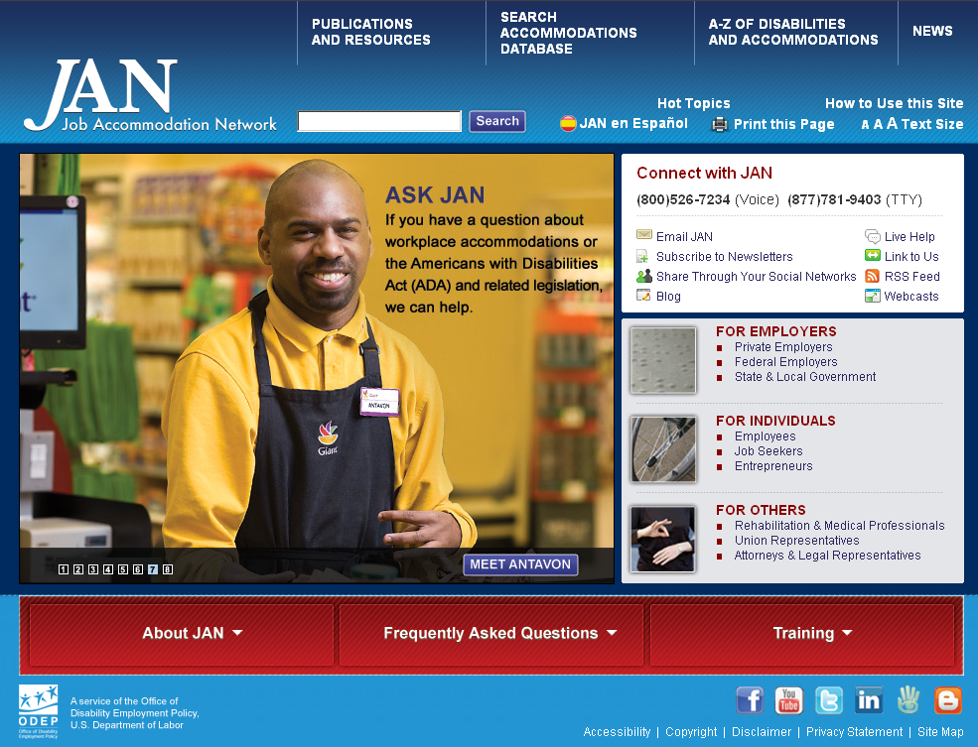
Job Accommodation Network
800-526-7234 (V/TTY)
www.askjan.org
JAN is the leading source of free, expert, and confidential guidance on workplace accommodations and disability employment issues. Working toward practical solutions that benefit both employer and employee, JAN helps people with disabilities enhance their employability, and shows employers how to capitalize on the value and talent that people with disabilities add to the workplace.
(800) 526-7234
www.askjan.org

Slide 66
Equal Employment Opportunity Commission
The EEOC provides access to Federal employment laws and regulations. The EEOC has publications on the Americans with Disabilities Act which include their policy guidance on various portions of the Act, fact sheets, Q&As, best practices, and other information.
www.eeoc.gov
www.eeoc.gov/laws/types/disability.cfm
1-800-669-6820 (TTD)

Slide 67
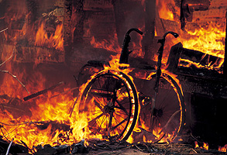
EMERGENCY PREPAREDNESS RESOUCES!
EEOC Fact Sheet on Obtaining and Using Employee Medical Information as Part of Emergency Evacuation Procedures www.eeoc.gov/facts/evacuation.html
National Fire Protection Association – Emergency Evacuation Planning Guide For People with Disabilities Evacuation Guide for People with Disabilities PDF. (nfpa.org)
Stairwell Use During an Emergency (includes people with disabilities) www.dol.gov/odep/documents/Stairwell.pdf
Disaster Readiness Tips for People with Sensory Disabilities www.brainline.org/article/disaster-readiness-tips-people-sensory-disabilities
Disaster Readiness Tips for People with Developmental or Cognitive Disabilities www.brainline.org/article/disaster-readiness-tips-people-developmental-or-cognitive-difficulties
Disaster Readiness Tips for People with Mobility Disabilities www.brainline.org/article/disaster-readiness-tips-people-mobility-disabilities
Disasters Readiness Tips for Owners of Pets or Service Animals www.diversitypreparedness.org/browse-resources/resources/NOD%20Pets%20Service%20Animals/
An ADA Guide for Local Governments: Making Community Emergency Preparedness and Response Programs Accessible to People with Disabilities https://www.ada.gov/emergencyprep.htm

Slide 68
Contact the Southwest ADA Center
with any Questions!
Hot Line: 1-800-949-4232
Web Site: www.southwestADA.org

