Slide 1
2010 Standards for
Accessible Design
Presented By:
Michael A. Edwards
Great Plains ADA Center

Slide 2

Update on DOJ’s ADA Standards
DOJ – Published as a Standard
Sept, 15 2010
Effective Date:
For all New and altered facilities
March 15, 2012

Slide 3
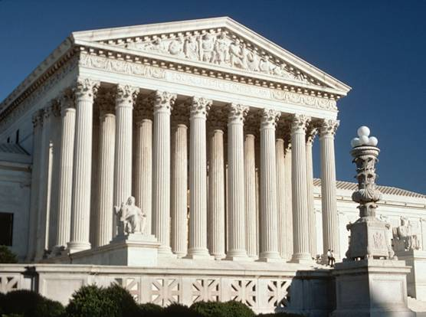
Department of Justice ADA Standards
The Department of Justice (DOJ) published updated ADA regulations based on the Access Board's guidelines.
These regulations include additional design requirements that supplement the standards.

Slide 4
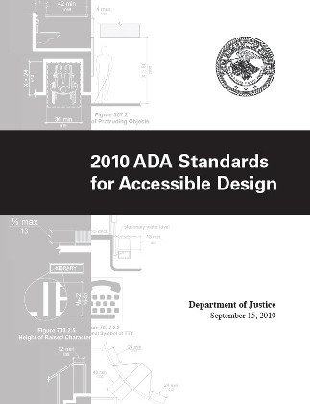

Update on DOJ’s ADA Standards

Slide 5
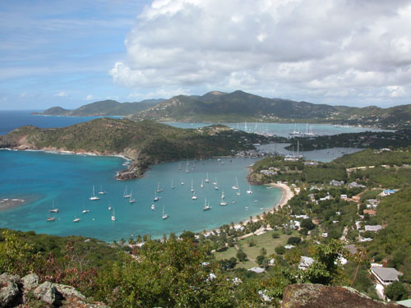
Safe Harbor and the 2010 SAD
If elements in an existing facility have not been altered on or after March 15, 2012, and these elements comply with the corresponding technical and scoping specifications in the 1991 Standards, they are not required to be modified in order to comply with the requirements set forth in the 2010 ADA Standards.

Slide 6
Safe Harbor and the 2010 SAD
Chapter 10 of the 2010 SAD did not exist.
Except where noted – Boating Facilities – every topic of Chapter 10 would be required to be made accessible now.
For Title II, this means a review of Program Access.
For Title III, this means RABR.

Slide 7
Elements in 2010 Standards not Subject to Safe Harbor
(A) Residential facilities dwelling units
(B) Amusement rides
(C) Recreational boating facilities
(D) Exercise machines and equipment
(E) Fishing piers and platforms
(F) Golf facilities
(G) Miniature golf facilities

Slide 8
Elements in 2010 Standards not Subject to Safe Harbor
(H) Play areas
(I) Saunas and steam rooms
(J) Swimming pools, wading pools, and spas,
(K) Shooting facilities with firing positions,
(L) Miscellaneous.
(1) Team or player seating
(2) Accessible route to bowling lanes
(3) Accessible route in court sports facilities

Slide 9
Path of Travel - Safe Harbor
If a covered entity has constructed or altered required elements of a path of travel in compliance with the applicable Standards (1991 or UFAS), before March 15, 2012, they are not required to retrofit such elements to reflect incremental changes in the 2010 Standards, just because they alter a primary function area served by the path of travel.

Slide 10
Updated ADAAG
Application and
General Scoping

Slide 11
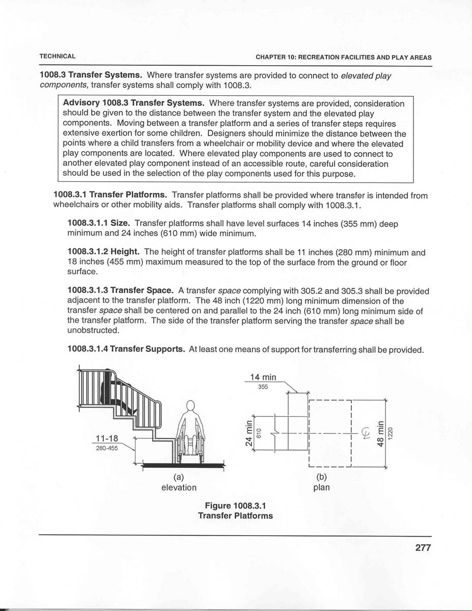
New Format
Numbering system
New figures (informational only)
All dimensions in text
(not just figures)
New advisory notes follow provision

Slide 12
ADAAG Supplements
Previous supplements included:
State & Local Gov’t Facilities (1998)
Children’s Environments (1998)
Play Areas (2000)
Recreation Facilities (2002)

Slide 13
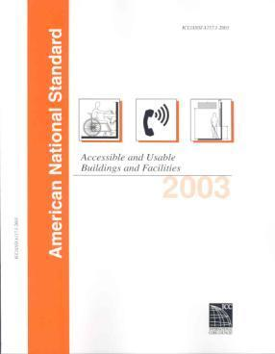

Harmonization
ICC/ANSI A117.1-2003 IBC 2003

Slide 14
Significant Changes to ICC/A117.1 2015
Anthropometric Changes to:
turning radius
Clear Floor Space
New Dimensions mentioned throughout PowerPoint

Slide 15
CHAPTER 1
Application and Administration
101 – Purpose
102 – Dimensions for Adults and Children
103 – Equivalent Facilitation
104 – Conventions
105 – Referenced Standards
106 – Definitions

Slide 16
Conventions
Dimensions – range instead of absolute dimension where possible
Construction and manufacturing tolerances
Calculation of percentages
Figures – informational; text governs

Slide 17
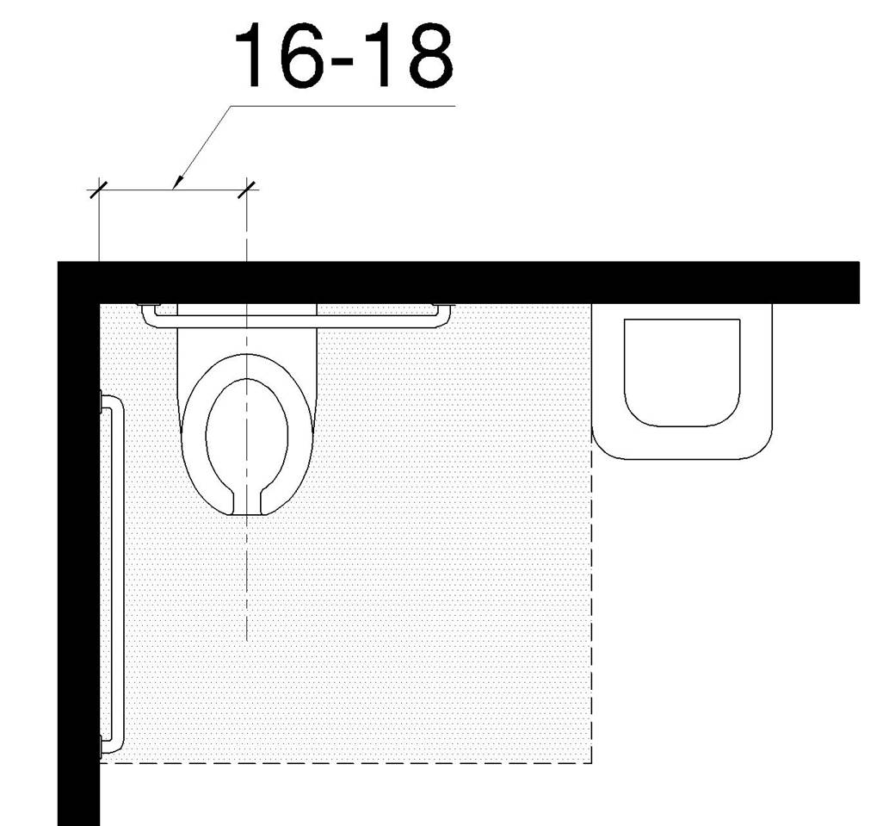
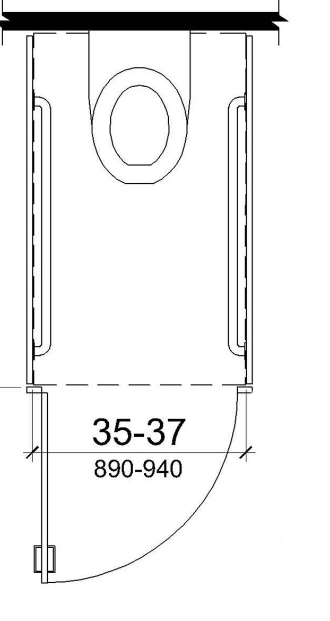
Ranges instead of absolute dimensions
Water closet centerline (16-18”)
Width of ambulatory accessible stall (35”- 37”)

Slide 18
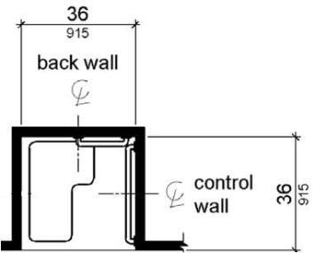
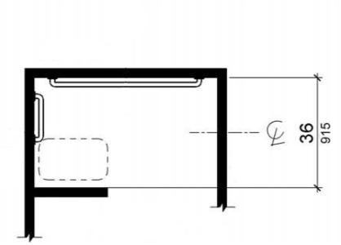
Some absolute dimensions remain
Transfer shower stall (36” x 36”) and combination transfer/roll-in design with seat on front wall (36” deep)
measured to center points; manufacturing tolerances recognized

Slide 19
Referenced Standards
powered doors (ANSI/BHMA A156.10 & A156.19)
elevators and lifts (ASME A17.1 & A18.1)
egress (IBC)
alarms (NFPA 72)
play surfacing & equipment (ASTM standards)

Slide 20
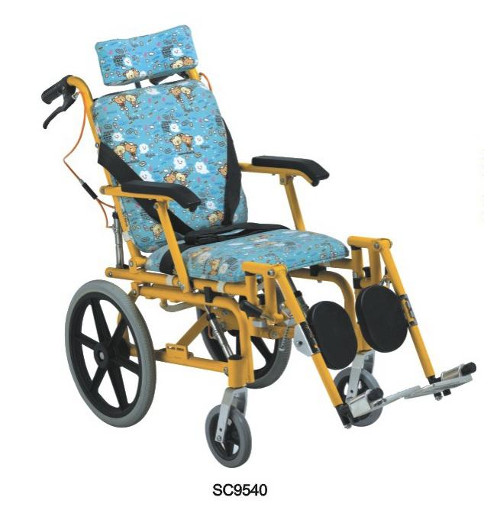
Adult and Children’s Dimensions
Anthropometrics drive the design
New children's guidance covers:
  Drinking fountains
  Water closets
  Toilet compartments
  Lavs/sinks
  Dining and work surfaces

Slide 21
Equivalent Facilitation
103 Equivalent Facilitation
Nothing in these requirements prevents the use of designs, products, or technologies as alternatives to those prescribed, provided they result in substantially equivalent or greater accessibility and usability.

Slide 22
CHAPTER 2
General Scoping and Exceptions

Slide 23
Application (201)
Premise:
All areas of newly designed/ constructed facilities to comply unless indicated
Exceptions more thoroughly covered

Slide 24
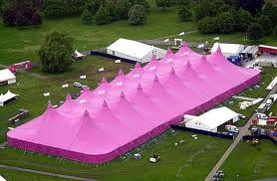
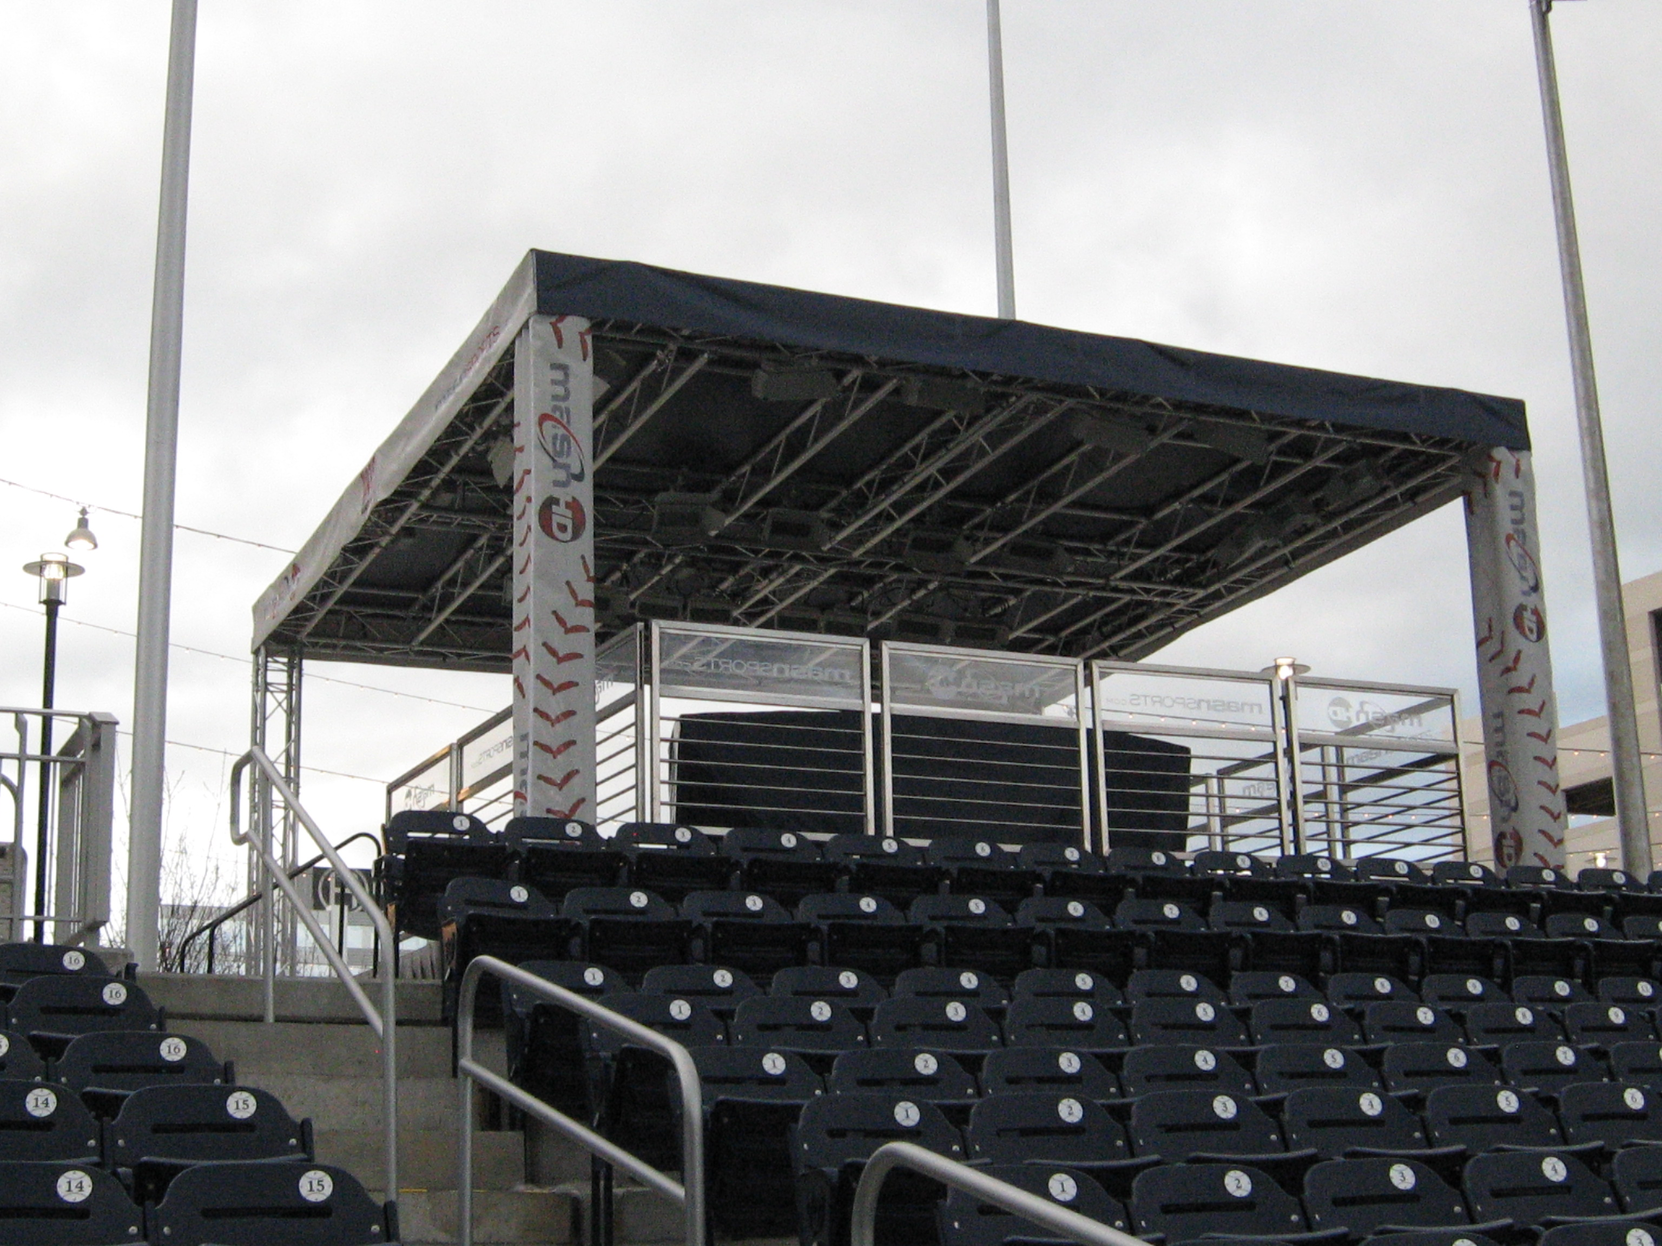
Temporary and Permanent Structures
201.3 – Regulations apply to both
Classrooms
Bleachers
Stages
Platforms/daises
Exhibits
NOT Construction

Slide 25
Existing Buildings and Facilities (202)
Additions
Alterations
(specific exceptions now located at relevant provision)
Primary Function Areas – Path of Travel
Qualified Historic Facilities

Slide 26
202- Additions, Alterations, Usability
Additions comply with the provisions for new construction
  Usability must be considered
Alterations: Redefined.
  Usability must be considered
  Path of travel and 20% non-proportionality

Slide 27
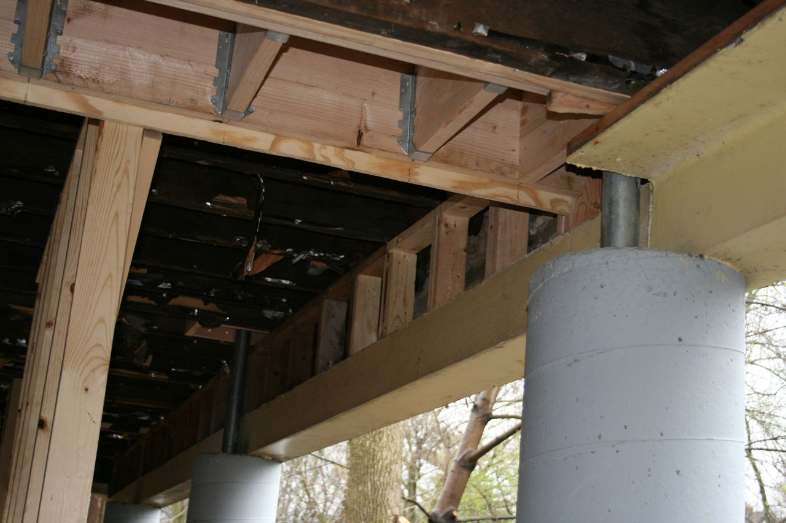
Alterations
TECHNICAL INFEASIBILITY
In alterations, where compliance with applicable requirements is technically infeasible, the alteration shall comply with the requirements to the maximum extent feasible.

Slide 28
Alterations: Primary Function Areas
202.4 Alterations Affecting Primary Function Areas.
An alteration that affects or could affect the usability of or access to an area containing a primary function shall be made so the path of travel to the altered area is readily accessible to and usable by individuals with disabilities
  unless such alterations are disproportionate to the overall alterations in terms of cost and scope

Slide 29
Alterations – Path of Travel
20% OF ALTERATION TO PRIMARY FUNCTION AREA
INCLUDES ROUTE AND
  Restrooms
  Telephones
  Drinking fountains

Slide 30
ALTERATIONS – PRIMARY FUNCTION AREA
EXAMPLES OF AREAS INCLUDED: EMPLOYEE WORK AREAS, PUBLIC AREAS, LOBBIES, ETC.
EXAMPLES OF AREAS NOT INCLULDED:
  MECHANCIAL, BOILER, OR SUPPLY ROOMS
  EMPLOYEE LOUNGES OR LOCKER ROOMS
  ENTRANCES OR CORRIDORS
  RESTROOMS

Slide 31
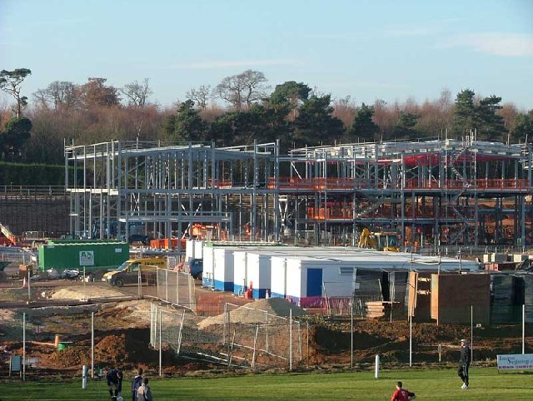
General Exceptions (203)
Sites, buildings, facilities and elements are exempt from these requirements…
Construction sites
Raised areas
Limited access spaces
Machinery spaces

Slide 32
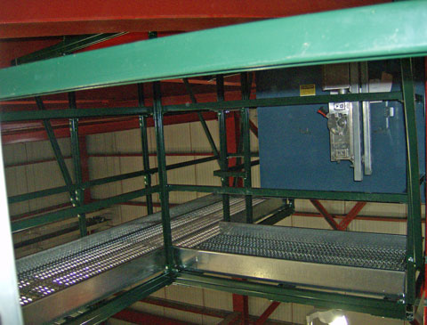
General Exceptions (203)
Single occupant structures (e.g., toll booths)
Certain common use spaces in detention and correction facilities and residential facilities
Employee work areas
Various spaces in recreation facilities

Slide 33
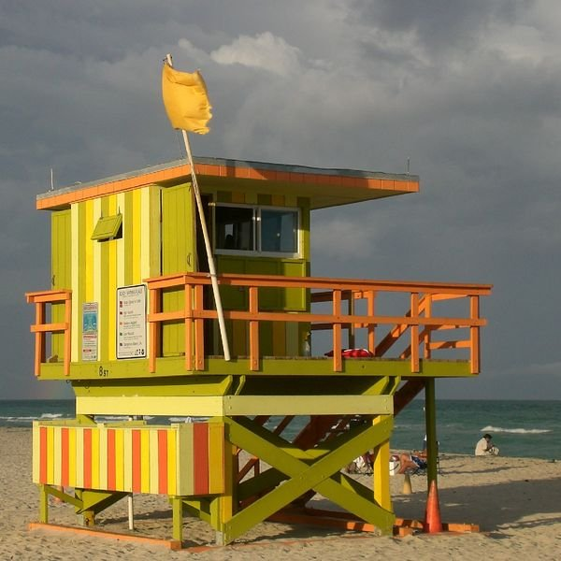
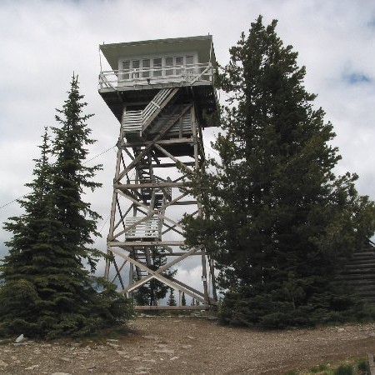
Raised Areas
Exempt: areas raised for security, life/fire safety

Slide 34
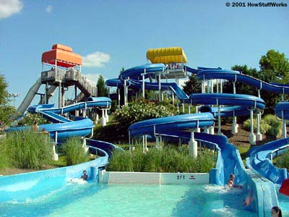
General Exceptions (203)
Raised referee judging and scoring areas
Water Slides
Animal containment areas
Raised boxing, wrestling rings
Diving boards and platforms

Slide 35
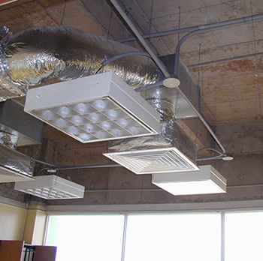
Operable Parts 205
When located on accessible elements, routes and rooms, comply with 309
EXCEPTIONS:
When intended for maintenance personnel, etc.
Dedicated electrical, communication &
floor receptacles
HVAC diffusers
Redundant controls
Exercise equipment

Slide 36
Accessible Routes (206)
Where required:
  Site arrival points
  Within sites
  (not req’d if no pedestrian route provided)
  Between stories (elevator exceptions)
  Space and elements
  Specific spaces (e.g., restaurant &
  cafeteria, performance area, press box)

Slide 37
Accessible Routes (206)
At least one route from parking and passenger loading, public streets and sidewalks and public transportation stops to:
  The accessible building or facility entrance they serve,
  Except:
  Historic structures from site arrival point to entrance
  If the only means of access is vehicular not providing a pedestrian route

Slide 38
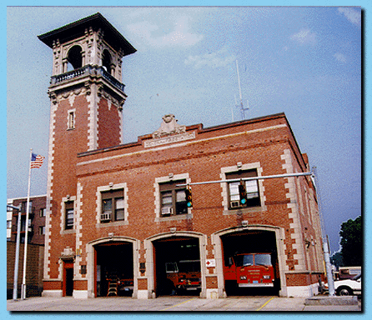
Vertical access
2nd floor vs. less than 3,000 sq. ft. aggregate
  Not allowed for doctor’s offices, malls, transportation facilities
Title II buildings – two stories and above.
Title III buildings – Three stories and Sq. footage combined.

Slide 39
Accessible Routes in multi story buildings -206.2.3
At least one route connecting stories and mezz
  Except:
  Private buildings 3000 S>F, less than 3 stories
    Except in: Shopping centers,
    malls,
    office of health care providers,
    terminals ,depots or stations for public transportation

Slide 40
Accessible Routes in multi story buildings -206.2.3
Public (Title II) buildings exceptions:
  Two stories, with an occupant load of 5 or fewer on one level.
  Certain detention and correction facilities
  Certain residential applications
  Certain transient lodging applications
  Air traffic control towers
  Historic structures in some applications

Slide 41
ADA Definition of Mezzanine
Mezzanine. An intermediate level or levels between the floor and ceiling of any story with an aggregate floor area of not more than one-third of the area of the room or space in which the level or levels are located.
Mezzanines have sufficient elevation that space for human occupancy can be provided on the floor below.

Slide 42
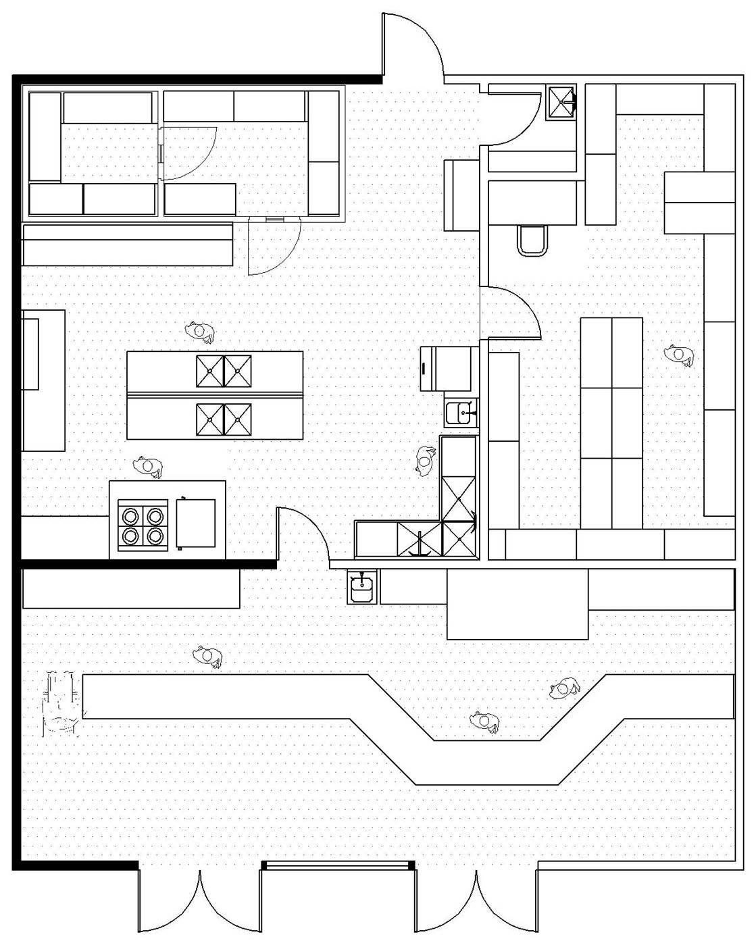
ADA Work Areas
“approach, entry,
& exit”
circulation paths (in areas ≥ 1000 sq ft)
means of egress
visual alarm
connection

Slide 43
Chapter 3
Building Blocks

Slide 44
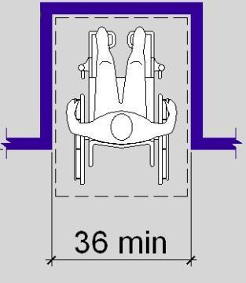
Building Blocks (Chapter 3)
Floor or Ground Surfaces
Changes in Level
Turning Space
Clear Floor/ Ground Space
Knee & Toe Clearance
Protruding Objects
Reach Ranges
Operable Parts

Slide 45
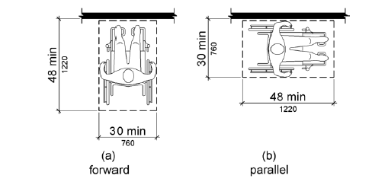
Anthropometrics

Slide 46
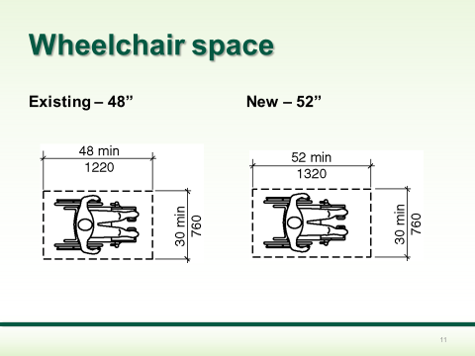
ICC Changes

Slide 47
Turning Space (304)
clarification:
overlap of turning space where knee/ toe clearance provided
doors can swing into turning space

Slide 48
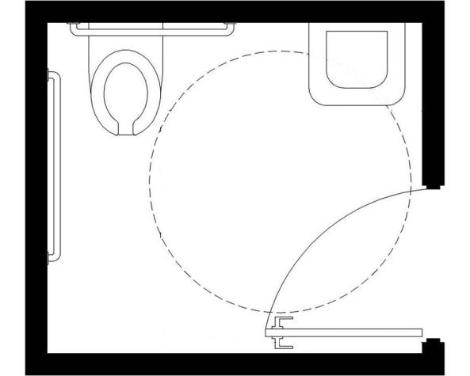
Turning Space (304)
60 inches

Slide 49
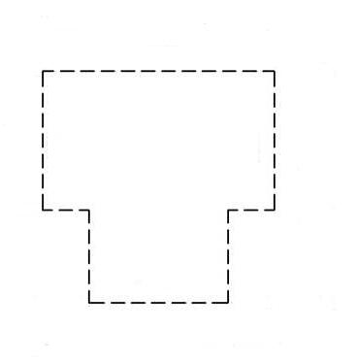
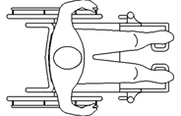
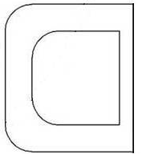
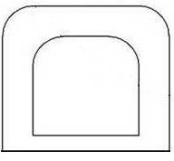
Turning Space (304)
Overlap permitted for only one arm of T-shaped space

Slide 50
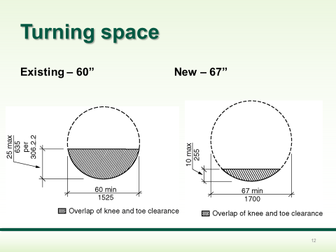
ICC Changes

Slide 51
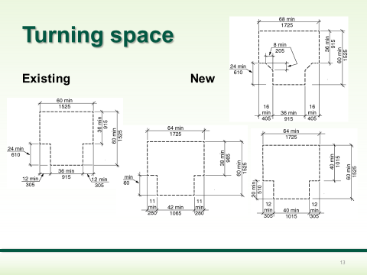
ICC Changes

Slide 52
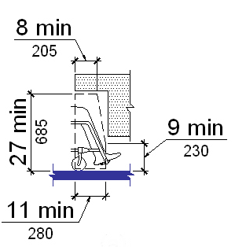
Knee Space (306)

Slide 53
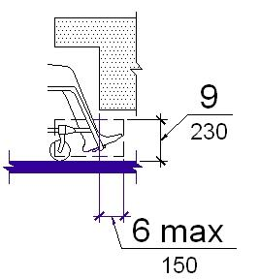
Toe Space (306)

Slide 54
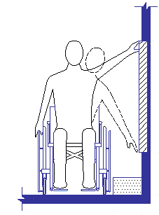
Reach Ranges (308)
Max. Reach – 48”
Min. Reach – 15”
(forward & side)

Slide 55
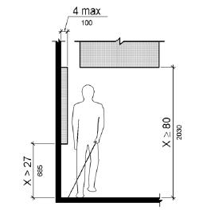
Protruding Objects
Figure 307.2 Limits of Protruding Objects

Slide 56
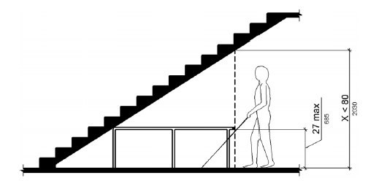
Figure 307.4 Vertical Clearance

Slide 57
Operable Parts
A clear floor or ground space complying with 305 shall be provided.
Operable parts shall be placed within one or more of the reach ranges specified in 308.
Operable parts shall be operable with one hand and shall not require tight grasping, pinching, or twisting of the wrist.
The force required to activate operable parts shall be 5 pounds maximum.

Slide 58
Accessible Routes
(Chapter 4)
Accessible Route Components
  walking surfaces
  doors, doorways, gates
  ramps
  curb ramps
  elevators
  limited use/ limited application elevators
  private residence elevators
  platform lifts

Slide 59
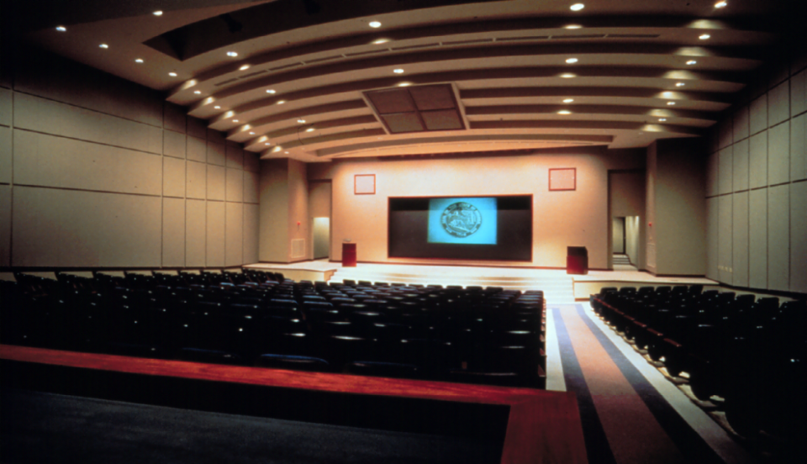
Performing Areas
“School board OKs stage ramps”

Slide 60
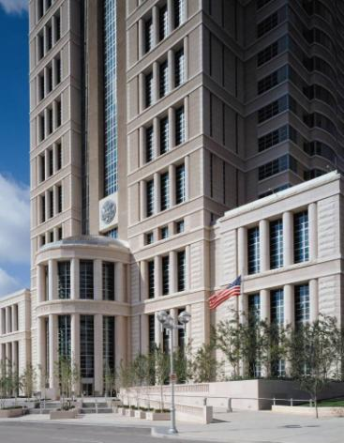
Entrances
At least 60% of public entrances to comply
Route to entrances to coincide with general circulation routes to maximum extent feasible

Slide 61
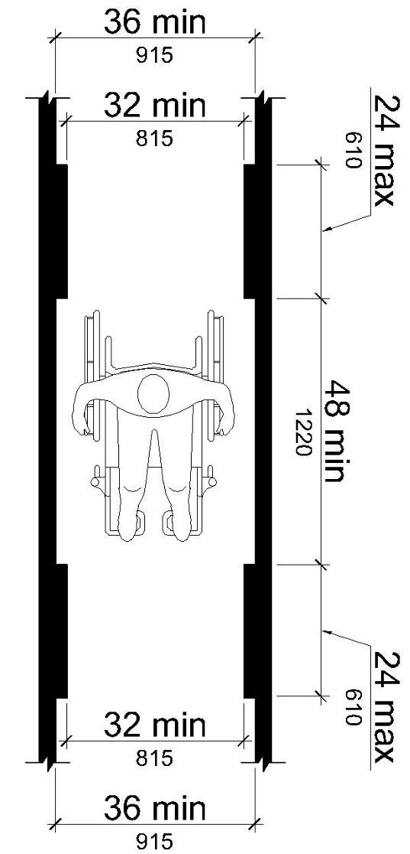
Walking Surfaces (403)
(Portions of accessible routes that slope no more than 1:20)
  Minimum separation (48”) between reduced clear widths
  Handrails along walking surfaces req’d to comply

Slide 62
Slope
Cross Slope should never exceed 1:48 (2%)
Running Slope never to exceed 1:20 (5%)
  Any slope greater than 1:20 is a ramp.

Slide 63
Doors - Clearances
Pullside clearance, forward approach
Clearance at doors in thick walls or that are recessed
(8” max. offset)

Slide 64
Doors – Clearances
Pushside clearance required at doors with a closer & latch

Slide 65
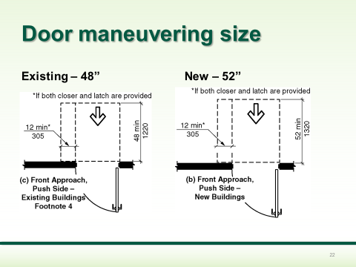
ICC Changes

Slide 66
Door and Gate Hardware
Handles, pulls, latches, locks, and other operable parts on doors and gates shall comply with 309.4. (Operable Parts)
Hardware shall be 34 inches minimum and 48 inches maximum above the finish floor or ground.
Where sliding doors are in the fully open position, operating hardware shall be exposed and usable from both sides.

Slide 67
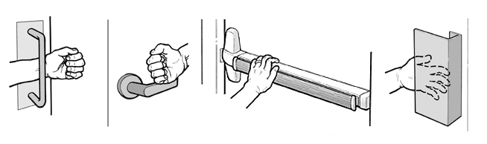
Door or Gate Hardware
NO tight grasping, pinching, or twisting of the wrist.

Slide 68
Thresholds at doorways
Thresholds, if provided at doorways, shall be 1/2 inch high maximum.
Raised thresholds and changes in level at doorways shall comply with 302 and 303.
EXCEPTION: Existing or altered thresholds 3/4 inch high maximum that have a beveled edge on each side with a slope not steeper than 1:2 shall not be required to comply with 404.2.5.

Slide 69
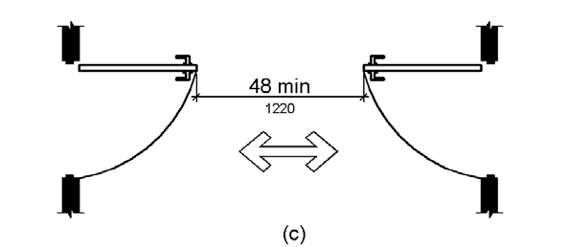
Doors in Series
New version allows both sets of doors to swing into space (with proper separation)

Slide 70
Doors in Series
Where doors are automated, provide wheelchair space at controls outside door swing

Slide 71
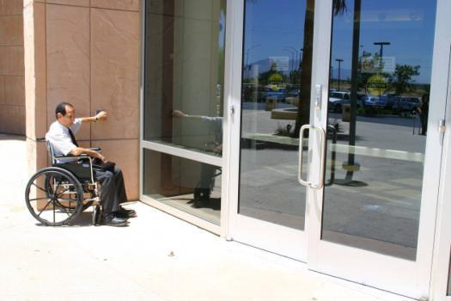
Entrances
Automated openers recommended for exterior doors
Required for Federal GSA buildings

Slide 72
Automatic & Power Assisted Doors & Gates (404.3)
Industry standards referenced:
Full-powered: ANSI/BHMA A156.10 (1999)
Low-energy and power-assisted: ANSI/BHMA A156.19 (1997 or 2002)
New provisions for break-out opening, clear floor space at controls

Slide 73
Automatic Doors: Clear Floor Space at Controls (404.3.5)
The clear floor space adjacent to the control shall be located beyond the arc of the door swing.
30” X 48” and on an accessible route

Slide 74
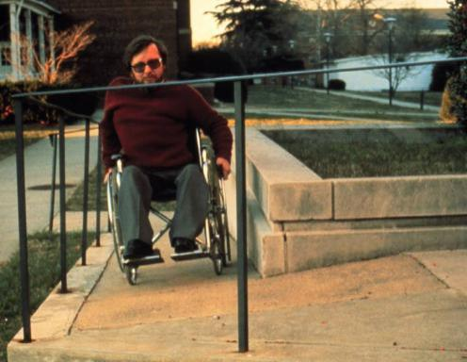
Ramps (405)
Slope:
  1: 12 max
Handrails (> 6” rise)
  both sides
  12” extensions
  34” to 38” height

Slide 75
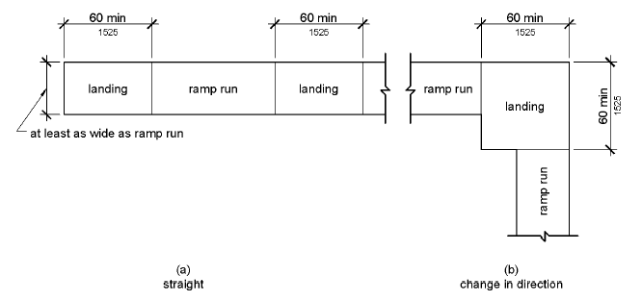
Ramps (405)
Level landings (1:48 max.)
Edge protection (clarified specs)
Exceptions for ramps in work areas (width, handrails)

Slide 76
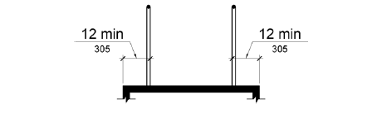
Ramps - Edge Protection
Edge protection complying with 405.9.1 or 405.9.2 shall be provided on each side of ramp runs and at each side of ramp landings.
405.9.1 Extended Floor or Ground Surface. The floor or ground surface of the ramp run or landing shall extend 12” minimum beyond the inside face of a handrail complying with 505.

Slide 77
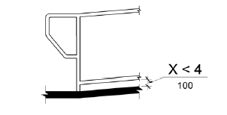
Ramps - Edge Protection
Edge protection complying with 405.9.1 or 405.9.2 shall be provided on each side of ramp runs and at each side of ramp landings.
405.9.2 Curb or Barrier. A curb or barrier shall be provided that prevents the passage of a 4 inch diameter sphere, where any portion of the sphere is within 4 inches (100 mm) of the finish floor or ground surface.

Slide 78
Curb Ramps
Smooth transition
Side flares or returned sides
Landing space (top and bottom)
Diagonal ramps discouraged
Detectable warnings

Slide 79
Curb Ramps
side flares returned sides

Slide 80
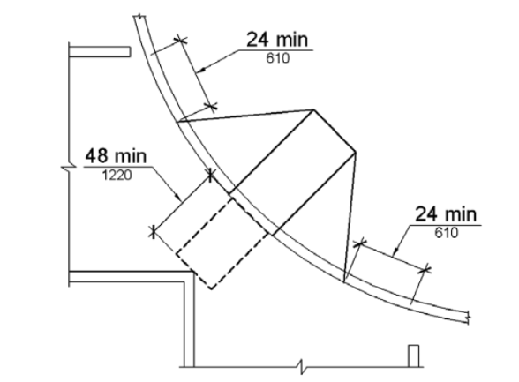
Curb Ramps
Bottom 4’ landing must be within crosswalk

Slide 81
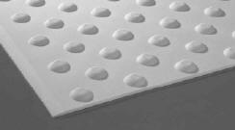
Detectable warnings
Curb ramps
On sites – no
Transit facilities - yes
Rulemaking on public rights-of-way developing more specific guidance

Slide 82
Platform Lifts (206.7)
Alterations – no restrictions
New Construction – restricted to:
  performance areas and speaker’s platforms
  wheelchair spaces
  incidental spaces
  existing site constraints (exterior)
  other

Slide 83
General Site & Building Elements (Chapter 5)
Parking
Passenger Loading Zones
Stairways
Handrails

Slide 84
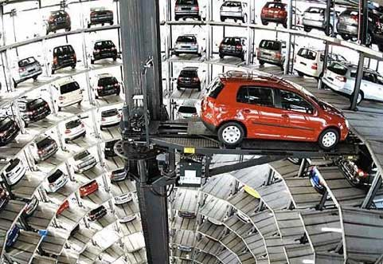
Parking spaces – 208
Applies to parking structures, lots. Calculated
separately in each facility.
1 to 25-1
26 to 50 -2
51 to 75 -3
76 to 100- 4
101 to 150 -5
151 to 200 -6
201 to 300 -7
301 to 400 -8
401 to 500 -9
501 to 1000 -2 percent of total
1001 and over 20, plus 1 for each 100, or fraction thereof

Slide 85
Parking (208)
Exception - spaces used exclusively for:
Bus, trucks, and other delivery vehicles
Law enforcement vehicles
Vehicular impound
These lots must have compliant passenger loading zone where public access is provided

Slide 86

Van Parking (208.2.4)
Van Spaces - 1 of every 6 accessible spaces (instead of 1 of 8)

Slide 87

Van Spaces (502)
8’
EX: Van space
Car space
Van space

Slide 88


Parking (502)
Marking of access aisles
Angled vans spaces (aisle on passenger side)
Sign height (60” min.)

Slide 89


Parking Spaces (502)
Identification
Signs shall include the International Symbol of Accessibility
van spaces shall contain the designation "van accessible.“
60” min above the finish floor or ground surface measured to the bottom of the sign.
Relationship to Accessible Routes Parking spaces and access aisles shall be designed so that cars and vans, when parked, cannot obstruct the required clear width of adjacent accessible routes.

Slide 90

Passenger Loading Zones (209)
At least 1 for every 100 linear ft. of loading zone space provided

Slide 91
Passenger Loading Zones
Aisles - same level as pull-up space
Aisles to be marked
No level changes in space or aisle

Slide 92
Handrails (505)
Handrail/ surface clearance: 1 ½” min. (not absolute)
Diameter: 1 ¼” – 2” (not 1 ½” max.)
Dimension applies to outer diameter (clarification)

Slide 93

Handrail Gripping Surface (505.6)
Continuous gripping surface
No obstructions on top or sides
Obstructions limited along bottom to 20%
1.5” min at bottom

Slide 94

Handrails (505.7)
gripping surface – more detail, more options
criteria for circular & non-circular cross sections

Slide 95
Plumbing Elements & Facilities (Chapter 6)
Drinking Fountains
Toilet & Bathing Rooms
Water Closets & Toilet Compartments
Urinals
Lavatories & Sinks
Bathtubs
Shower Compartments
Grab Bars
Seats
Washing Machines & Clothes Dryers
Saunas & Steam Rooms

Slide 96

Drinking Fountains (211)
Where provided on an exterior site or floor,
2 required: wheelchair accessible & standing access
alternative: single unit with
dual access (e.g., “hi-lo” units)
multiple installations:
50% of each type

Slide 97

Toilet & Bathing Facilities (213)
Scoping for rooms & elements (e.g., toilets, lavs, mirrors)
toilet rooms clustered
at 1 location: 50% scoping
unisex toilet rooms
Urinals - access where
more than 1 provided

Slide 98
Toilet Rooms & Water Closets (603 & 604)
Range for toilet centerline
lavatory cannot overlap toilet clearance (except in dwelling units)

Slide 99

Toilet Rooms & Water Closets (603 & 604)
a fixture can be recessed
shorter (24” min.) rear grab bar allowed

Slide 100

Toilet & Bathing Rooms (603)
Space for side transfers provided

Slide 101

Toilet & Bathing Rooms (603)
Door can swing into fixture clearances if clear floor space provided beyond door swing

Slide 102
Water Closets (604)
Other changes/ clarifications:
objects permitted to overlap clearance (grab bars, dispensers, etc.)
flush controls (standard reach range)
toilet paper dispenser location

Slide 103

Water Closets (604)
revised location for toilet paper dispenser

Slide 104

Water Closets (604)
grab bars clearances (609.3) further determine location of non-recessed dispensers

Slide 105

Water Closets (604)
large dispensers can conflict with grab bar clearance

Slide 106
Toilet Compartments (604)
compartments with > 1 fixture to meet room requirements
removed alternate stall designs (technical infeasibility)

Slide 107

Wheelchair Compartments (604)
Standard Stall
60” min. wide
depth:
56” min. (wall hung toilet)
59” min. (floor-mounted or children’s toilet)

Slide 108

Ambulatory Accessible Stalls (604)
depth specified (60” min.)
width: 35”- 37” (instead of 36” absolute)

Slide 109

Urinals (605)
minimum depth specified
17” max rim height
* Accessibility only required if more than one urinal is provided

Slide 110

Lavatories & Sinks (606)
apron clearance (29” min.) removed
parallel approach - kitchen sinks in spaces without cook tops/ conventional ranges
removable cabinetry - sinks & lavs in dwelling units (if certain conditions met)

Slide 111
Bathtubs & Shower Compartments (607& 608)
hand-held shower spray (on/off control)
water temperature (120 degrees max.)
grab bars – can be adaptable in private bathrooms & dwelling units bathrooms

Slide 112

Bathtubs (607)
additional 12” clearance beyond permanent seat

Slide 113

Shower Compartments (608)
Alternate design permitted in any facility

Slide 114

Figure 608.2.1 Transfer Type Shower Compartment Size and Clearance

Slide 115

Figure 608.2.2 Standard Roll-In Type Shower Compartment Size and Clearance

Slide 116
Grab Bars (609)
wider diameter – 2” max. (instead of 1 ½”)
circular and non-circular cross sections
(4” – 4.8” perimeter dimension; 2 ” max. cross section dimension)

Slide 117

Grab Bars (609)

Slide 118

Grab Bars (609)
12” min. clearance above
1 ½” min. below

Slide 119
Grab Bars
609.4 Position of Grab Bars. Grab bars shall be installed in a horizontal position, 33 inches (840 mm) minimum and 36 inches (915 mm) maximum above the finish floor measured to the top of the gripping surface

Slide 120
Saunas & Steam Rooms (612)
from supplement on recreation facilities
bench
turning space

Slide 121
Communication Elements & Features (Chapter 7)
Fire Alarm Systems
Signs
Telephones
Detectable Warnings
Assistive Listening Systems
ATMs & Fare Machines
Two-Way Communication Systems

Slide 122
Fire Alarm Systems (215)
public and common use areas
employee work areas (wiring)
transient lodging
residential facilities
alterations: compliance required where system upgraded or replaced or a new one is installed

Slide 123

Fire Alarm Systems (702)
NFPA 72
(1999 or 2002)
guidelines require
110 dB max.

Slide 124

Visual Alarms (702)
NFPA 72 covers:
flash rate & pulse duration
location - wall & ceiling
minimum intensity
(based on coverage area)
larger coverage thru fewer appliances
many spaces (other than corridors) can be covered by 1 appliance
synchronization of multiple appliances

Slide 125
Signs (216)
Specific provisions for:
Means of egress
  Exit doors: Visual and Tactile (703.1, .2, & .5)
    Plus Braille for Raised Characters (703.3)
  Areas of Refuge (instructions and directions to): Visual (703.5)

Slide 126
Signs (216)
Specific provisions for:
Parking
  Signage at spaces comply with 502.6
  Where a total of four or fewer parking spaces, including accessible spaces, are provided on a site, parking signage shall not be required.
  In residential facilities, where parking spaces are assigned to specific residential dwelling units, parking signage shall not be required

Slide 127
Signs (216)
Specific provisions for:
Entrances
  Where not all entrances comply with 404, entrances complying with 404 shall be identified by the International Symbol of Accessibility complying with 703.7.2.1.
  Directional signs complying with 703.5 that indicate the location of the nearest entrance complying with 404 shall be provided at entrances that do not comply with 404.

Slide 128
Signs (216)
Specific provisions for:
Toilet and bathing rooms
  Where existing toilet rooms or bathing rooms do not comply with 603, directional signs indicating the location of the nearest toilet room or bathing room complying with 603 within the facility shall be provided.
  Directional signs shall comply with 703.5 and shall include the International Symbol of Accessibility complying with 703.7.2.1.

Slide 129
Signs (216)
Specific provisions for:
Toilet and bathing rooms
      Where existing toilet rooms or bathing rooms do not comply with 603, the toilet rooms or bathing rooms complying with 603 shall be identified by the International Symbol of Accessibility complying with 703.7.2.1.
      Where clustered single user toilet rooms or bathing facilities are permitted to use exceptions to 213.2, toilet rooms or bathing facilities complying with 603 shall be identified by the International Symbol of Accessibility complying with 703.7.2.1 unless all toilet rooms and bathing facilities comply with 603.

Slide 130

Tactile Signs (703)

Slide 131
Detectable Warnings
Where required:
Transit platforms (8.10.5)
Curb ramps at transit facilities (DOT rule) – bottom 2’
Public streets & sidewalks – recommend use of draft ROW guidelines

Slide 132

Detectable Warnings (705)
greater range of designs & products allowed
dome diameter (range)
spacing (range)
removed:
resiliency/ sound-on-cane contact
color contrast

Slide 133

ATMs & Fare Machines (220 & 707)
Access to 1 of each type at each location
speech output
privacy
input controls
display screen
Braille instructions (for speech mode)

Slide 134
Special Rooms, Spaces & Elements (Chapter 8)
Assembly areas
Dressing, fitting, and locker rooms
Kitchens and kitchenettes
Medical care and long-term care
Transient lodging
Prison cells
Courtrooms
Dwelling units
Transportation facilities
Storage

Slide 135

Assembly Areas (221)
Wheelchair Spaces
lower scoping for
assembly areas with
more than 500 seats:
501 – 5,000 seats: 1 space/ every 150 seats (instead of 1%)
> 5,000: 0.5% scoping

Slide 136

Scoping: Assembly Areas

Slide 137

Assembly Areas (221)
Dispersion of wheelchair
spaces to provide
choices of seating
locations and viewing angles
substantially equal to, or better than,
the choices of all other spectators

Slide 138

Assembly Areas (221)
Exceptions for areas with 300 or fewer seats if:
horizontal – spaces & companion seats located in the 2nd or 3rd quartile of row
vertical – if viewing angles = or better than the average viewing angles in the assembly area

Slide 139


Wheelchair Spaces (802)
Lines of Sight
Seated Spectators
  Over heads
  Between heads
Standing Spectators
  Over heads
  Between heads

Slide 140

Wheelchair Spaces (802)
Circulation paths cannot overlap wheelchair spaces

Slide 141

Assembly Areas (221)
Other Changes:
Companion seat
for each space
(can be movable)
Designated aisle seats - 5% of aisle seats
Lawn seating - accessible route

Slide 142

Companion Seats and Designated Aisle Seats (802)
Companion Seats
  Alignment
  Type
Designated Aisle Seats
  Armrest
  Identification
1:48

Slide 143

Dressing, Fitting, & Locker Rooms (222)
Access to at least 5% of each type of use in each cluster
(no change from original ADAAG)

Slide 144

Dressing … & Locker Rooms (803)
Door swing into turning space (if wheelchair space beyond swing)
A bench complying with 903 is required

Slide 145

Holding and Housing Cells
Judicial (231)
Detention/Correctional (232)
Judicial Facility
Central Holding
Court-Floor Holding
Detention/Correctional
General Holding/Housing
  - Mobility 3%*
  - Comms. 2%
Special and Medical
Visiting Areas Alterations
*as per DOJ regulation

Slide 146

Holding and Housing Cells (807)
Mobility Features
- turning space
- benches
- beds
- toilet and bathing
Communication Features
- alarms
- telephones

Slide 147


Courtrooms
Judicial Facilities (231.2)
Scoping
Each court room
Technical (808)
turning space
clear floor spaces
counters/tables

Slide 148

Transportation Facilities (218)
Scoping (each)
Rail stations
Bus shelters
Other
  public address systems
  clocks

Slide 149


Transportation Facilities (810)
Bus Boarding Area
Surface
Dimensions
Connection
Slope
Shelters
Bus Signs

Slide 150

Built-In Elements (Chapter 9)
Dining & Work Surfaces
Benches
Check-Out Aisles & Service Counters

Slide 151

Dining & Work Surfaces (226)
Access to at least 5%, not fewer than 1
[no change from UFAS and original ADAAG]

Slide 152

Sales & Service (227 and 904.4)
227 Scoping
Counters – 1 of each type
Cash register not factor
904.4 Technical
Accessible part same depth
Parallel or forward approach
No alternatives
Exception for alterations
Security glazing – voice communication

Slide 153



Work Surface (902) Service Counter (904)
36” max
34” max
36” max
34” max

Slide 154

[changing] Benches (903)
Size: (42” min. long, 20” – 24” deep)
clear floor space (parallel-short axis

Slide 155





Recreation Facilities (Chapter 10)

Slide 156


Sports Facilities
Area of sport activity defined as:
“That portion of a room or space where the play or practice of sport occurs”
Accessible route to each “area of sport activity”
Exempt from firm, stable, and slip resistant surface provision (302.1 EX2)

Slide 157

Exercise Equipment and Machines

Slide 158

Team player seating areas
Team player seating areas
  Platform lift permitted

Slide 159

Area of sport activity
Court Sports -
Accessible route to directly connect both sides of the court

Slide 160

Accessible route connecting various elements of a multi-use facility

Slide 161

Accessibility not required to or in:
Raised boxing or wrestling rings
Raised structures solely for refereeing, judging, or scoring a sport.

Slide 162


Fishing piers and platforms
Accessible routes serving floating piers/platforms – use boating gangway exceptions
Design gangway to 1:12 OR provide up to a 30 foot gangway
At least 25 percent of the railings, guards, or handrails shall be 34 inches (865 mm) maximum above the ground or deck surface.

Slide 163

Fishing piers and platforms
Railings
  Where provided
  Maximum 34 inch height for 25% of the railing
  Lowered railing dispersed
  Exception: where a guard is provided which complies with ICC/IBC

Slide 164

Fishing piers and platforms
Edge protection – where railings are provided – 2 inch minimum
30 inches x 48 inches clear space
At least one maneuvering space

Slide 165

Play Areas (240 and 1008)
Contains play components
Designed and constructed for children
Separated by age ranges for safety

Slide 166



What is a Play Component?
A play component is an element designed to generate specific opportunities for play, socialization, and learning.

Slide 167

Ground-Level Requirements
“One of Each Type”
More than one — integrated in the play area
Ground-Level requirements based on number of Elevated Play Components

Slide 168


Minimum Number of
Elevated Components
50% of all elevated play components in a play area must be reached by an accessible route
20 or more elevated components:
25 % ramp + 25% ramp and/or transfer = 50%
Less than 20 elevated components:
ramp and/or transfer = 50%

Slide 169
Based on the number of elevated play components provided, and using the table
Number and Types of Ground Level Play Components Required to be on Accessible Route
Number of Elevated Play Components Provided
Minimum Number of Ground Level Play Components Required to be on Accessible Route
Minimum Number of Different Types of Ground Level Play Components Required to be on Accessible Route
Minimum quantity of
ground-level play
components
Minimum number of
different types
1
Not applicable
Not applicable
2 to 4
1
1
5 to 7
2
2
8 to 10
3
3
11 to 13
4
3
14 to 16
5
3
17 to 19
6
3
20 to 22
7
4
23 to 25
8
4
More than 25
8 plus 1 for each additional 3 over 25, or fraction thereof
5

Slide 170


Swimming pools
Required means of access into the water
  Over 300 linear ft of pool wall = 2
  Less than 300 linear ft of pool wall = 1
Lift or sloped entry
Second means - lift, sloped entry, transfer wall, stairs, or transfer system

Slide 171

Sloped Entry
Extend to 24 inches to 30 inches below stationary water level
1:12 maximum slope
Handrails – 33 inches – 38 inches clear width

Slide 172

Pool lift
Located where water does not exceed 48 inches
Footrests – must be provided and move with seat.
Armrest – if provided opposite water shall be removable or fold in raised or load position
Capable of unassisted operation – both deck and water

Slide 173



Other means of access into the water

Slide 174

Wading pools
At least one sloped entry – handrails not required
Extend to the deepest part of the wading pool

Slide 175

Water play components
Where water play components are provided, ground level access and transfer access to elevated play components required

Slide 176

Accessibility not required to or on:
Water slides
Accessible route required to edge of catch pool

Slide 177

Saunas and Steam Rooms
Where provided in a cluster, at least 5%, not less than one
Turning space within the room—may be obstructed by readily removable seats
Door swing can not swing into clear floor/ground space for bench

Slide 178
Resources
ACTCP- Great Plains ADA Center
100 Corporate Lake Dr
Columbia, Mo 65203
573-882-3617
Southwest ADA Center
TIRR Memorial Hermann - ILRU
1333 Moursund
Houston, TX 77030
800-949-4232 or 713-797-7171.

