Slide 1
Self-Evaluation and Transition Plans
Presented by
Mike Edwards

Slide 2
Self Evaluation
All public entities subject to Title II of the ADA must complete a self-evaluation by
January 26, 1993
(One year from the effective date of DOJ's regulation)

Slide 3
Title II Overview
Title II of the ADA covers all State and Local Government entities
All programs and services offered by the entity is covered by Title II
  Programs and services
  Policies
  Employment
  Facility Access
Title II entity much achieve “Program Access”
  Title III- Readily Achievable Barrier Removal

Slide 4
Who is subject to Title II?
A public entity covered by Title II is defined as:
Any state or local government, regardless of size
Any department, agency, special purpose district, or other instrumentality of a state or local government
Certain commuter authorities and AMTRAK

Slide 5
What Activities are Covered?
Title II prohibits discrimination against qualified individuals with disabilities by public entity activities, including:
All services & programs offered by the entity
All aspects of the employment relationship
Government services carried out by contractors
Activities of state or local legislative & judicial branches
Public transportation

Slide 6
How is Title II Enforced?
ADA provides 3 methods of enforcement:
File a complaint under the public entity's grievance procedure
File a complaint with a designated federal enforcement agency
File a lawsuit

Slide 7
What is Program Access?
Requires that individuals with disabilities have an equal opportunity to participate in all programs and activities conducted by the Title II covered entity
Such access is to be provided in the most integrated setting, with each person participating as independently as possible

Slide 8
Basic Title II Requirements
Requires a Self Evaluation or assessment of services, policies, practices, and procedures
Requires a Transition Plan where physical changes are necessary to achieve program access (if 50 or more employees)

Slide 9
Procedural Requirements
Physical Modifications- to be completed by Jan 26, 1995 - 28 CFR 35.150(c)
Designation of an official responsible for ADA implementation (better known as an
“ADA Coordinator”) - 28 CFR 35.107(a)
Set up a Grievance Procedure (if 50 or more employees) – 28 CFR 35.106
Notice to the Public – 28 CFR 35.106

Slide 10
What are Self-Evaluation and Transition Plans
Title II requires all facilities, programs, and policies be reviewed for accessibility and to make sure individuals with disabilities are not being discriminated against.
Self-Evaluation is a “Snapshot” of where your entity stands at this point in time.
Transition plan- A plan of action for removing barriers at facilities

Slide 11
Determine 50 or more Employees
Determination of whether a local government has more than fifty employees is based upon the government wide total of both full-time and part-time employees.
Employees of all departments, divisions, and subunits of a city or county government are considered.
For example, Anytown's breakdown of employees is as follows:
City Hall 8 employees (3 part-time)
Fire Department 10 employees
Police Department 10 employees (2 part-time)
Sanitation Department 7 employees
Public Works 12 employees
Health Department 5 employees (3 part-time)
Even though no single division of Anytown's overall government has more than 50 employees, because the total number of employees is 52, Anytown is required to meet the obligations for an entity with 50 or more employees.

Slide 12
50 or more Employees (cont.)
Under Title II, public school districts that employ 50 or more persons must also meet ADA administrative requirements. As with city and county governments, the total number of part-time and full time employees (teachers, administrators, maintenance, cafeteria, etc.) for the entire school district are considered in the total number of employees.
Public entities with less than fifty employees are not required to appoint an ADA Coordinator and establish a grievance procedure, but they are strongly encouraged to do so to effectively facilitate ADA compliance.

Slide 13
Establishing the ADA Coordinator Position
When appointing an ADA Coordinator, the public entity needs to establish:
A job description
The amount of time given to the position: if the position is full-time or will be combined with other duties.
How the ADA Coordinator fits into the administrative hierarchy, will the ADA Coordinator report directly to the Mayor or City Manager, Human Resources, etc.
The level of authority the ADA Coordinator has over other employees and departments.
The level of autonomy the ADA Coordinator has in making decisions and carrying out duties.
The level of involvement the ADA Coordinator has in overall city administration. Will the ADA Coordinator attend city council meetings, meet frequently with the City Manager, be involved in city planning/administration issues?
What level of training, resources, and administrative support will the position receive?
Levels of communication and how and to whom the ADA Coordinator will report problems and areas of need.
Notes:
Appointing an ADA Coordinator is meaningless without a corresponding job structure. It may seem obvious to say that an ADA Coordinator needs to know what their job entails and to whom they report, but, in reality, it is not uncommon for an ADA Coordinator to be appointed without clearly defining the details of the position. As one ADA Coordinator described her role within a city, "I have responsibilities, but I don't have any authority, and I'm not even sure who my boss is, so I can't ask how I'm performing!“
Some local/state governments establish the above criteria and then appoint or hire an ADA Coordinator. Other entities prefer to select the individual who will take on the role of ADA Coordinator and then establish the professional structure of the role with the input of the ADA Coordinator. Either approach is satisfactory depending upon the needs of the community.

Slide 14
Establishing the ADA Coordinator Position (2)
The job description of the ADA Coordinator should reflect the intent of Title II regulations, which is to coordinate a state or local governments efforts to comply with and fulfill its responsibilities under title II, including the investigation of complaints. The responsibilities of an ADA Coordinator should include:
conducting a self-evaluation
conducting a transition plan
establishing and overseeing grievance procedures
monitoring on-going progress of the transition plan
communicating policy within the organization and throughout the community.
coordinating activities among a number of departments.
identifying and utilizing appropriate resources.
establishing a working knowledge of ADA regulations and guidelines.
assisting in development of policies and procedures
working closely with the disability community

Slide 15
Establishing the ADA Coordinator Position (3)
Certification
ADA Coordinator Training Certification Program verifies that participants have completed training in required content areas and have a depth of knowledge in ADA issues.
Upon completion of the program, ACTCP certifies a knowledge-based essential to performing the role of an ADA Coordinator
www.adacoordinator.org

Slide 16
Grievance Procedure
The grievance procedure should include:
Description of how and where a complaint under Title II may be filed with the government entity
Statement notifying potential complainants that alternative means of filing will be available to people with disabilities who require such an alternative

Slide 17
Grievance Procedure (2)
The grievance procedure should include:
Description of the time frames and processes to be followed by the complainant and the government entity
Information on how to appeal an adverse decision
Statement of how long complaint files will be retained

Slide 18
Grievance Procedure (3)
Grievance procedure should be distributed to all agency heads
Post copies in public spaces of public building and on the government’s website
Update the procedure and the contact information as necessary
In addition, the procedure must be available in alternative formats so that it is accessible to all people with disabilities

Slide 19
Why do a Self-Evaluation and Transition Plan Now?
The ADA is over 30 years old
Think about all that has changed in the last 30 years
  Technology
  Web sites
How has your disability community changed
Do you have the same programs
Has there been updates to your facilities

Slide 20
Why do a Self-Evaluation and Transition Plan Now? (2)
Was it done initially?
Was it done RIGHT the first time?

Slide 21
Revised DOJ Regulations
New regulations effective March 15, 2011
  Mobility devices
  Service animals
  Ticketing
  Effective Communication
  Residential Facilities
  Detention & Correctional Facilities
  Safe Harbor

Slide 22
Revised DOJ Regulations (2)
New regulations effective March 15, 2012
  2010 Standards for Accessible Design
  Hotel Reservations (effective 2012)

Slide 23
2010 Standards for Accessible Design
Effective March 15, 2012
Revised regulations allow the new Standards for Accessible Design to be used now although not required to comply

Slide 24
Compliance Dates
Between September 15, 2010 and March 15, 2012, covered entities may choose between the 1991 Standards, the Uniform Federal Accessibility Standards (UFAS), and the 2010 Standards when making architectural changes.
On March 15, 2012, compliance with the 2010 Standards will be required for new construction and alterations
Covered entities that should have complied with the 1991 Standards or the UFAS during any new construction or alteration of facilities or elements, but have not done so by March 15, 2012, must comply with the 2010 Standards.
On or after March 15, 2012 entities must consider any facility previously covered by supplemental requirements.

Slide 25
Safe Harbor
If constructed or altered elements of a path of travel
are in accordance with the specifications in either the 1991 Standards or the Uniform Federal Accessibility Standards before March 15, 2012…
…the public entity is not required to retrofit such elements to reflect incremental changes in the 2010 Standards solely because of an alteration to a primary function area served by that path of travel

Slide 26
Safe Harbor (2)
Safe Harbor does not apply to elements subject to supplemental standards such as:

Slide 27
Safe Harbor (3)
(A) Residential facilities dwelling units
(B) Amusement rides
(C) Recreational boating facilities
(D) Exercise machines and equipment
(E) Fishing piers and platforms
(F) Golf facilities
(G) Miniature golf facilities
(H) Play areas

Slide 28
Safe Harbor (4)
(I) Saunas and steam rooms
(J) Swimming pools, wading pools, and spas
(K) Shooting facilities with firing positions
(L) Miscellaneous:
  (1) Team or player seating, section 221.2.1.4.
  (2) Accessible route to bowling lanes, section. 206.2.11.
  (3) Accessible route in court sports facilities, section 206.2.12.

Slide 29
Self Evaluation-look at polices
What do your policies say?
How do they affect people with disabilities?

Slide 30
What to Evaluate?
The Self-Evaluation 13
Must examine each program to determine whether any physical barriers to access exist and identify steps to be taken to enable these programs to be made accessible. -Added to Transition Plan.

Slide 31
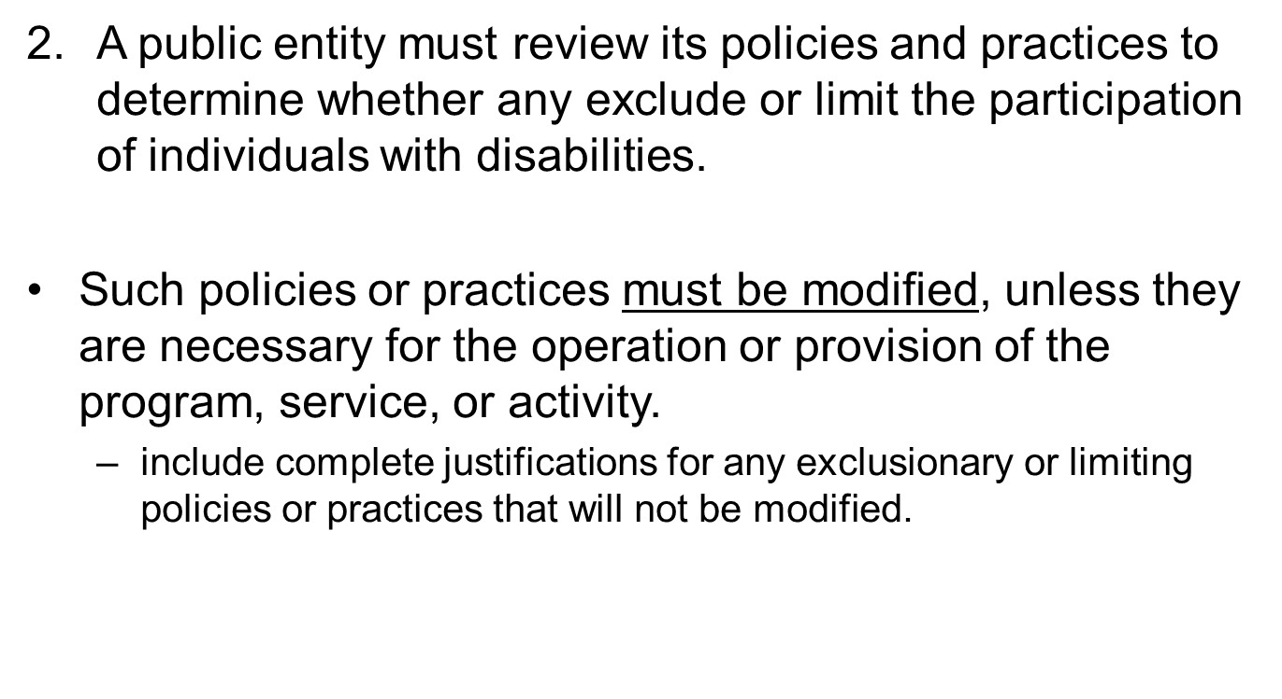
(2)

Slide 32
(3)
3. A public entity should review its policies to ensure that effective communication will be provided.
if providing telephone emergency services, it should review its policies to ensure direct access to individuals who use TDD's.
Policy Example: City has policy of giving 48 hours’ notice for interpreter

Slide 33
(4)
4. Ensure to include provisions for auxiliary aides such as interpreters and other alternative communication measures
A method for securing these services should be developed, including guidance on when and where these services will be provided.
Where equipment is used as part of a public entity's program, activity, or service, a public entity should have policies that ensure that its equipment is maintained in operable working order.
Should also have a schedule for maintenance of equipment

Slide 34
(5)
5. A review should be made of the procedures to evacuate individuals with disabilities during an emergency.
May require the installation of visual and audible warning signals and special procedures for assisting individuals with disabilities from a facility during an emergency.

Slide 35
(6)
6. Review of a public entity's written and audio-visual materials to ensure that individuals with disabilities are not portrayed in an offensive or demeaning manner.

Slide 36
.
7. If operating historic preservation programs, review policies to ensure priority of methods that provide physical access to individuals with disabilities.
Deviations from the 2010 Standards are allowed as to not destroy the historic significance of the building.
2010 Standards address additional exceptions

Slide 37
(7)
7. If operating historic preservation programs, review policies to ensure priority of methods that provide physical access to individuals with disabilities.
Deviations from the 2010 Standards are allowed as to not destroy the historic significance of the building.
2010 Standards address additional exceptions

Slide 38
(8 & 9)
8. Ensure that decisions concerning a fundamental alteration in the nature of a program, activity, or service, or a decision that an undue financial and administrative burden will be imposed by Title II, are made properly and expeditiously.
9. Review policies and procedures to ensure that individuals with mobility impairments are provided access to public meetings.

Slide 39
(10)
10. Review employment practices to ensure that they comply with other applicable nondiscrimination requirements, including section 504 of the Rehabilitation Act and the ADA regulation issued by the Equal Employment Opportunity Commission.

Slide 40
(11)
11. Review building & construction policies to ensure that the construction of each new facility or part of a facility, or the alteration of existing facilities conforms to the standards. (now 2010 Standards)

Slide 41
(12)
12. A review should be made to ascertain whether measures have been taken to ensure that employees of a public entity are familiar with the policies and practices for the full participation of individuals with disabilities.
- In other words, make sure employees have been trained on ADA practices and procedures

Slide 42
(13)
13. If a public entity limits or denies participation in its programs, activities, or services based on drug usage, it should make sure that such policies do not discriminate against former drug users.

Slide 43
Self Evaluation-practices
Need to look at all program policies, as well as, assess how they are practiced.
  Look at all “we’ve always done it this way” scenarios.
  Written and unwritten policies.

Slide 44
ADA Compliance Team
Members should be from each department
Meet a minimum of once a quarter
Provide updates on ADA compliance for each department
Guide ADA Policy Implementation
Be a Liaison with disability advocates in the community

Slide 45
Program Interviews
Department heads/employees should be interviewed using a developed survey questionnaire that can be used to determine
  If a program is fully accessible
  If a program has known or unknown discriminatory features

Slide 46
Survey Questions
Should include questions on:
Qualifications of program
Accessibility of physical location
Communication
Transportation
Auxiliary Aids
Service Animals
Other Power Driven Mobility Devices

Slide 47
Advisory Council
In addition to surveying department programs, an advisory council should be established.
The advisory council should:
  Consist of members representing the disability community
  Provide entity information about programs and services
  Be included in determining priorities for transition plan

Slide 48
Advisory Council (2)
Persons with disabilities are important stakeholders in the self-evaluation/transition plan process.
Including them means:
  A more realistic or practical view of accessibility and priorities
  Decisions are more likely to address serious unseen problems
When stakeholders are truly part of the process they are more likely to take ownership and help further implementation.

Slide 49
Reasonable Modifications
Changes to policies, practices, and procedures to ensure individuals with disabilities can participate and benefit from the program, service, or activity.
Unless the modification would fundamentally alter the nature of the program.

Slide 50
ADA Defenses
Direct threat to the health or safety of others
Individualized assessment; nature; duration; severity of the risk; probability that the potential injury will actually occur; can the reasonable modifications, auxiliary aids or services mitigate the risk?
Fundamental alteration to the nature of the service, program, or activity
Undue financial and administrative burden
Public entity has burden of proof

Slide 51
Self Evaluation-
Department Survey
Develop survey form to assess programs for accessibility-
Train team of staff members from different departments to carry out survey interviews
Department team should fill out survey form for each department program
Information goes into database

Slide 52
Review of Policies, Practices & Procedures
Does the policy, practice or procedure screen out or prohibit individuals with disabilities from participating in and enjoying the benefits of the program, service or activity?

Slide 53
Documents
Organizational and departmental procedure manuals
Brochures on city programs, services and activities
Rules and/or regulations specific to the services of the department or unit
Employment applications
Employee handbook
Emergency preparedness plans
Licensing criteria and applications
Special use permits
Waivers and release forms
Sample meeting and other public notices
Complaint form
Specific departmental/unit procedures for serving people with disabilities through provisions of auxiliary aids, service or modification of policies.

Slide 54
Self Evaluation- facilities
Perform access surveys on all facilities to determine if any barriers exist
Record this information in your database to be prioritized and used in the transition plan

Slide 55
Site Surveys
Entity may contract this out or perform themselves
Needs to be thorough and accurate
Should be organized to aid in prioritization
Existing technical standards should be applied to the extent possible

Slide 56
PREPARING FOR SITE REVIEWS
Get Organized
Preparation
Tools
Checklists
Physical Site Inspection
Survey Write-Up/Reporting
Maintenance Over-Time

Slide 57

Get Organized – The Power of 2
One person can conduct a survey, but it’s easier with two people. One person can take the measurements and the other person can fill out the checklist and take photos.
A partner also will provide a second opinion and help assure you don’t accidentally “miss” something.

Slide 58
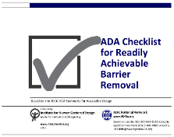
Choose a Checklist
Checklists make it easier to organize your thoughts, details all the technical requirements and helps keep you on track. It also helps avoid missing an item. Make sure you know what the goal of the checklist is. Some are for new construction, some are for existing facilities. Make sure the checklist matches your goals.
There is one good checklist available online.
http://www.adachecklist.org
(this one is referenced in our presentation and is for “readily achievable barrier removal”)

Slide 59
Readily Achievable Checklist
Technical Contents
The checklist details some of the requirements found in 2010 Standards
What the checklist is not:
Does not cover all requirements;
Is not intended for facilities under going new
construction or alterations; and
Does not attempt to illustrate all possible barriers or solutions to barriers - ADAAG should be consulted for detailed information

Slide 60
Checklist Priorities
The checklist is based on four priorities recommended by the Title III Regulations for planning readily achievable barrier removal projects:
  Accessible Approach and Entrance
  Access to Goods and Services
  Access to Restrooms
  Any Other Measures

Slide 61
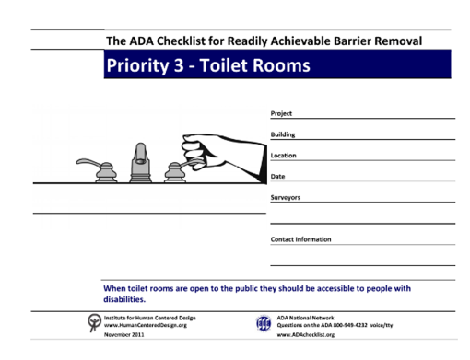
Make Copies of the Checklist
Determine how many copies of each section of the checklist you need. For example, most facilities have more than one toilet room.

Slide 62
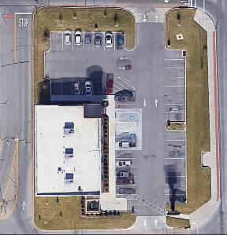
Use Free and Effective Online Tools
Google Earth
  Overall Tie In to Surrounding Environment/Community
  Parking Features and Layout
  Gain Sense of
  Slope/Topographical Characteristics
  Another Perspective
  Informs On-Site Questions/Areas of Focus

Slide 63
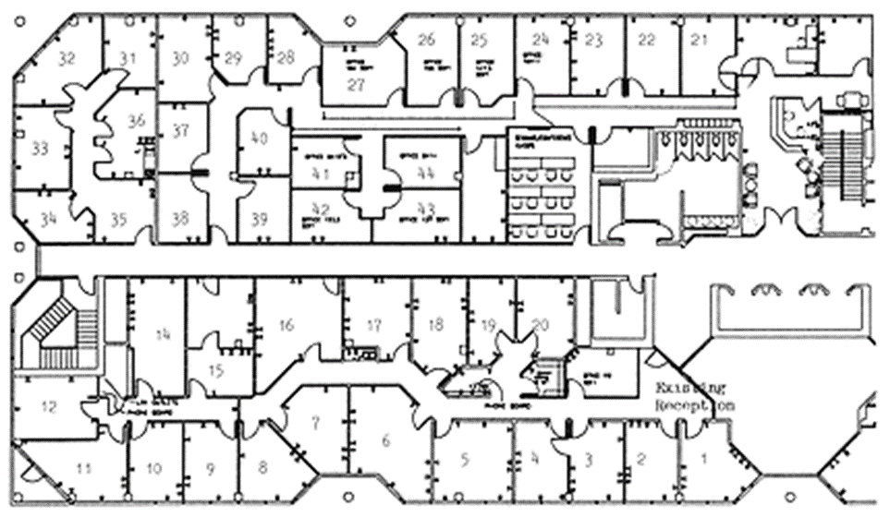
Obtain Floor Plans
A floor plan or sketch helps the surveyors get oriented and know how many elements, such as drinking fountains and entrances, there are and where they are. If plans are not available, sketch the layout of interior and exterior spaces.

Slide 64
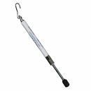
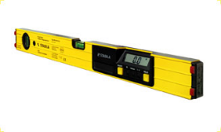
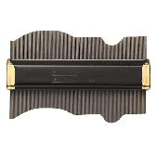
Essential Tools
Writing Tablet (and multiple pens)
Accessibility Guidelines/Checklist
Tape Measure
Digital Level
Door Pressure Gauge
Camera
Tool to measure small
changes in level/thresholds

Slide 65

Other Helpful Tools
Recorder
Clip Board
Door Stop-Survey in Progress sign
Blueprint and/or map of site
Backup batteries and other supplies
Quick-reference sheets
  Maneuvering clearance at doors
  Water closet specs
  Recreation Guides

Slide 66
Site Surveys- where to start
Tie in with surrounding features (sidewalks, transportation stops, etc.)
Overall parking resources and how they are addressed (by lot or overall)
  Shortest accessible route
  Judgment regarding dispersion
Accessible routes to all necessary spaces
Signage (directional and identifying spaces)

Slide 67
SITE INSPECTION
Stick to the Regulation –
It’s only a barrier (violation) if the specifications in the standards say it is

Slide 68
SITE INSPECTION (2)
Approach the site systematically –
The more uniform each site is surveyed, the easier it will be for the person doing the write up (parking, exterior facilities, entrances, first floor second floor, etc.)

Slide 69
SITE INSPECTION (3)
Specific Measurements –
  Always take specific measurements
  and write them down – don’t write
  phrases such as “seems”, “appears”, “looks”, etc.

Slide 70
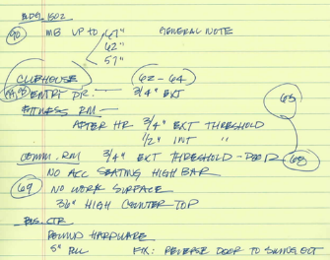
Note Taking
Write down/document everything
  -Even if you think a specific item only “may be” a barrier, write it down.
Take a photo – you can check ADAAG specifications later.
Detail barrier locations

Slide 71
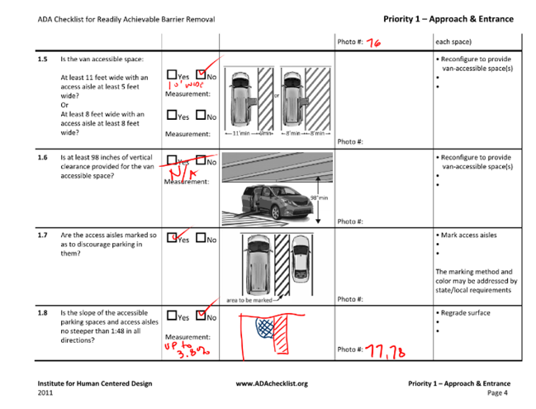
Notes in the checklist

Slide 72
Performing Surveys
Performing Surveys
(Highlighted elements)

Slide 73
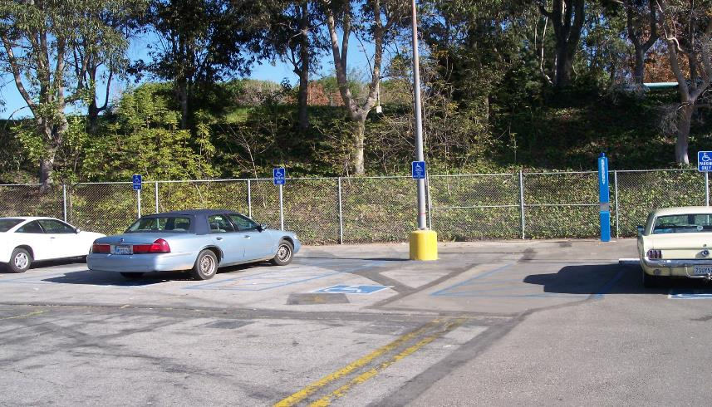
Element 1- Parking

Slide 74
Required Parking Spaces
Table 208.2
Total Parking in Lot | Required Minimum Number of Accessible Spaces
1 to 25 | 1
26 to 50 | 2
51 to 75 | 3
76 to 100 | 4
101 to 150 | 5
151 to 200 | 6
201 to 300 | 7
301 to 400 | 8
401 to 500 | 9
501 to 1000 | 2 percent of total
1001 and over | 20 plus 1 for each 100 over 1000

Slide 75
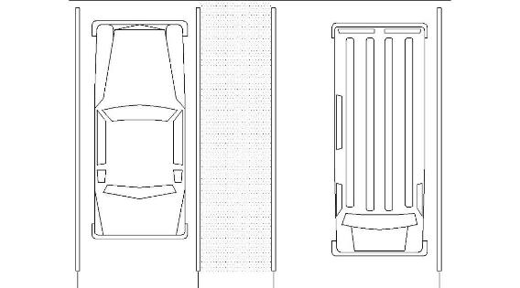
Van Parking
Van Spaces - 1 of every 6 accessible spaces

Slide 76
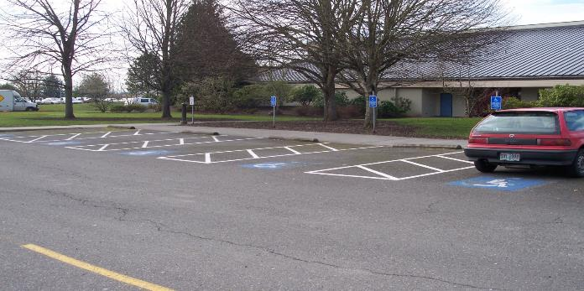
Parking Location
Accessible parking spaces should be located on the shortest accessible route

Slide 77
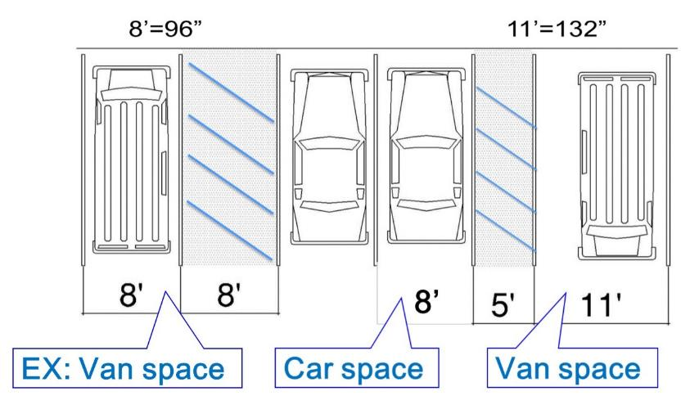
Parking Spaces

Slide 78
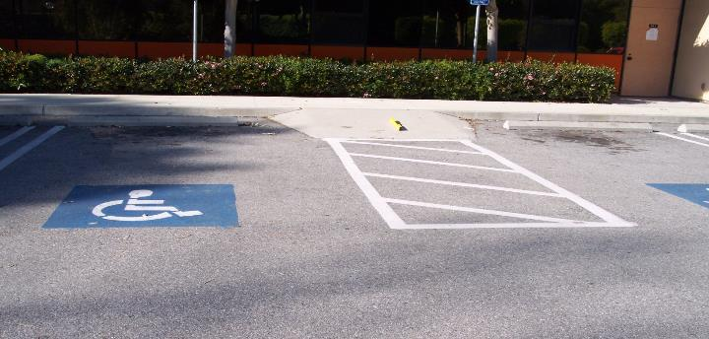
Floor or Ground Surfaces
Surfaces should be stable firm and slip resistant.
Access aisles should be the same level as the spaces they serve
Slopes not steeper than 2% shall be permitted

Slide 79
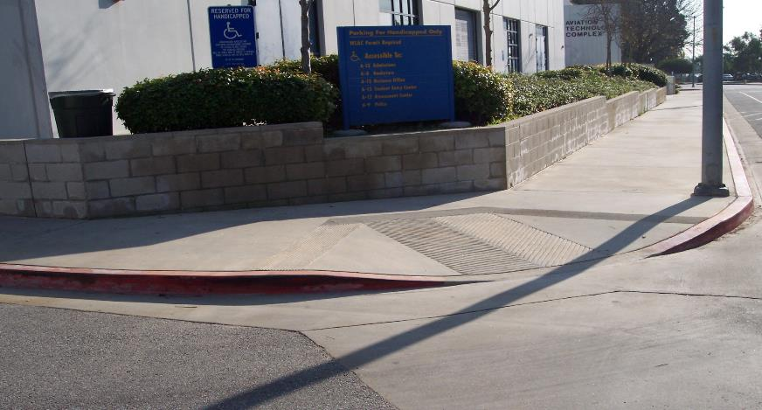
Element 2 Accessible Routes

Slide 80
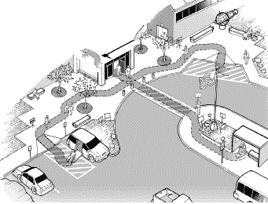
Site Arrival Points
At least one accessible route shall be provided from:
Parking spaces
Loading Zones
Streets & Sidewalks
Public transportation
stops

Slide 81
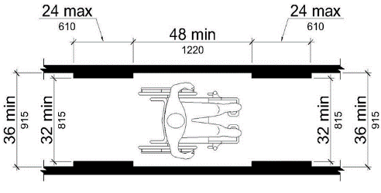
Clear Width
Clear width shall be a min. of 36”
  Exception: May reduce to 32” for a max distance of 24” provided there is at least 42” between reduced segments
*Note: If route is less than 60”, a passing space of 60” x 60” min must be provided every 200’

Slide 82
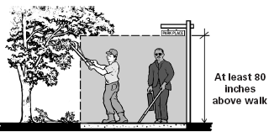
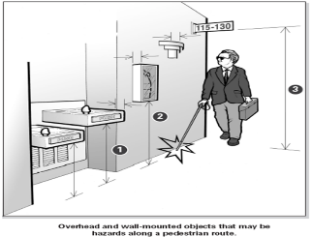
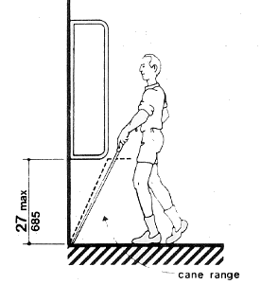
Protruding Objects
Any object above 27” and below 80” that protrudes into the path of travel more than 4”
Most protruding object barriers can be fixed with little or no cost

Slide 83
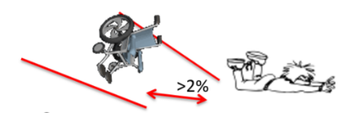
Slope
Running slope of an accessible route should not exceed 1:20 slope (5%)
  Once over 1:20 slope the route becomes a ramp
Cross Slope should NEVER exceed more than 1:48 (2%)

Slide 84
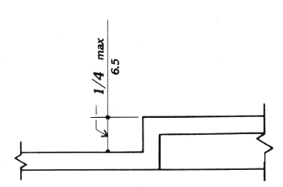
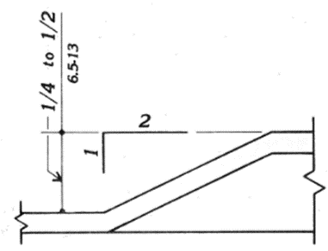
Changes in Level
Changes in level shall be 1/4 inch max vertical.
Changes in level 1/4 inch to ½ inch shall be beveled with a slope no greater than 1:2

Slide 85
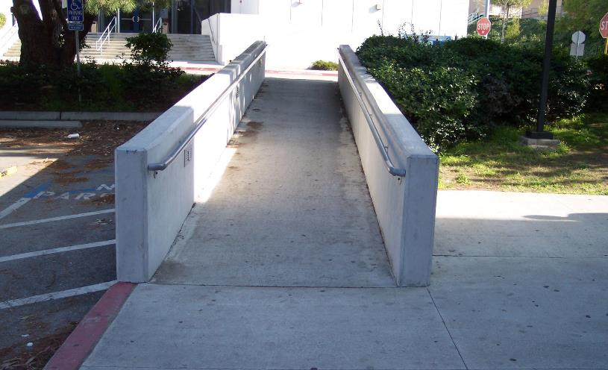
Element 3- Ramps, Curb Ramps
& Handrails

Slide 86
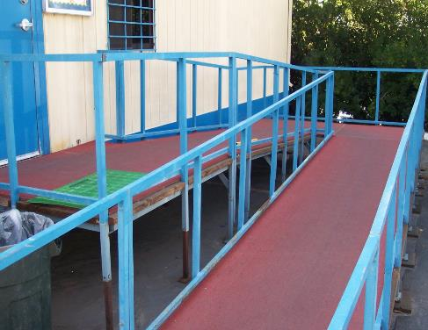
Slope, Clear Width, Rise
Max slope in new construction shall be 1:12.
Min clear width of a ramp shall be 36 in between handrails.
Max rise for any run shall be 30 in.

Slide 87
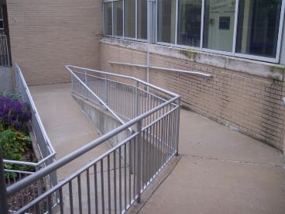
Landings
Ramps shall have level landings at bottom and top of each ramp and each ramp run. Landings shall have the following features:
The landing shall be at least as wide as the ramp run leading to it.
The landing length shall be a minimum of 60 in clear
If ramps change direction at landings, the minimum landing size shall be 60 in by 60 in

Slide 88
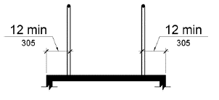
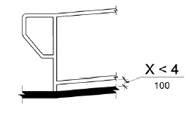
Edge Protection
Edge protection complying with 405.9.1 or 405.9.2 shall be provided on each side of ramp runs and at each side of ramp landings.
405.9.1 Extended Floor or Ground Surface. The floor or ground surface of the ramp run or landing shall extend 12 inches (305 mm) minimum beyond the inside face of a handrail complying with 505.
405.9.2 Curb or Barrier. A curb or barrier shall be provided that prevents the passage of a 4 inch (100 mm) diameter sphere, where any portion of the sphere is within 4 inches (100 mm) of the finish floor or ground surface.

Slide 89
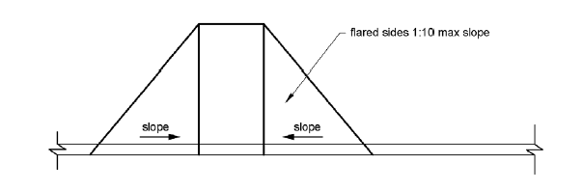
Sides of Curb Ramps
Where provided, curb ramp flares shall not be steeper than 1:10.
Fared sides should be provided whenever there is a perpendicular path of travel

Slide 90
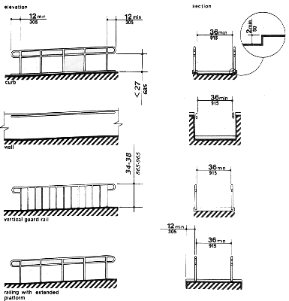
Ramp Handrails
Top of handrail gripping surfaces shall be mounted between 34 in and 38 in above ramp surfaces.
Ends of handrails shall be either rounded or returned smoothly to floor, wall, or post.
Handrails shall not rotate within their fittings

Slide 91

Element 4- Entrances
& Interior Doors

Slide 92
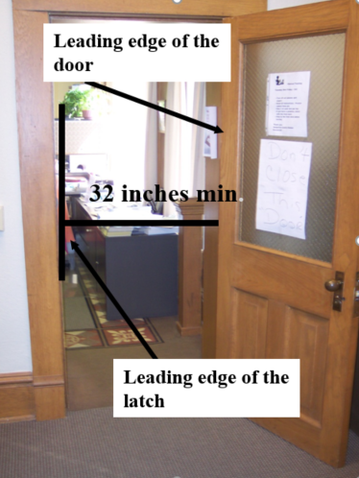
Entrances-Clear Width
Doors must have a min. of 32 inches of width
Measured from the leading edge of the latch to the leading edge of the door when door is in 90 degree position

Slide 93
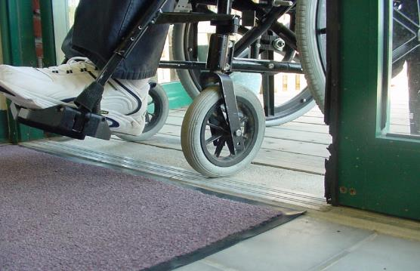
Thresholds
Same as
change of level requirements

Slide 94

Door Hardware
Operable parts of door or gate hardware shall be 34 inches minimum and 48 inches maximum above the finish floor or ground.
Door hardware must be usable without tight grasping or turning of the wrist.
Door opening force shall be 5lbf max for interior doors. (Exterior reserved)

Slide 95
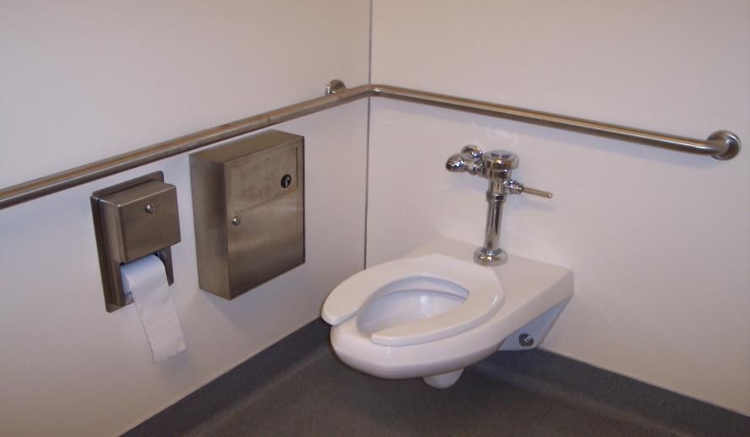
Element 5- Restrooms

Slide 96
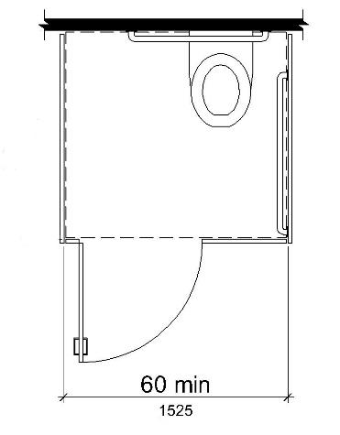
Wheelchair Compartment Size
Standard Stall
60” min. wide
Depth:
56” min. (wall hung toilet)
59” min. (floor-mounted or children’s toilet)
Children’s use dimensions are now addressed

Slide 97
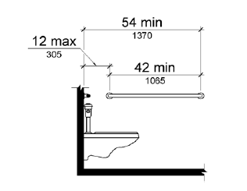
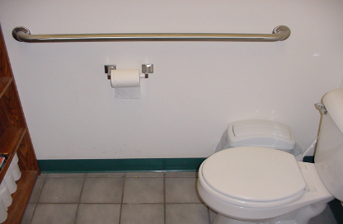
Grab Bars-Side Wall
33-36 in. high
42 in. min length
Must extend to 54in min.
12 in. max from back wall

Slide 98
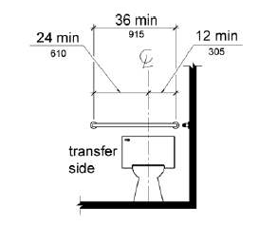
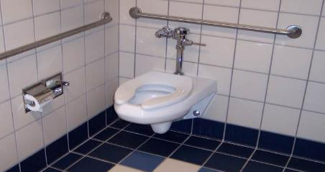
Grab Bars- Rear Wall
33-36 in. high
36 in. min. length
Must cover 12 in. from either
side of the center line of the toilet

Slide 99
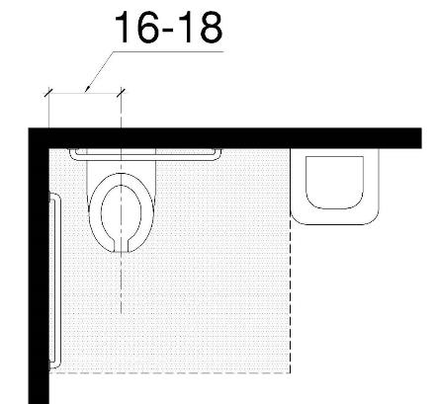
Water Closets
Centerline of the Toilet should be from 16” to 18” from the side wall
Flush Controls shall be on the open side of the toilet
Seat Height shall
be 17”- 19”

Slide 100
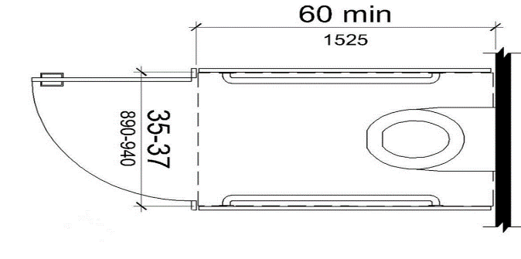
Ambulatory Compartment
Ambulatory accessible compartments shall have:
Depth of 60” min
Width of 35”minimum - 37” max.

Slide 101
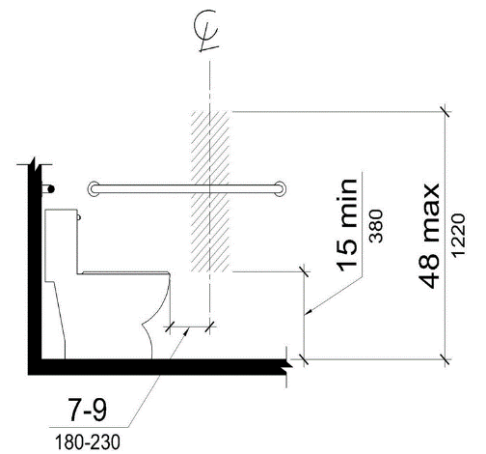
Dispensers
Toilet Paper dispenser may now be above grab bar. However, 12” must be clear above grab bar (unless recessed)
Instead of the back wall, the front of the bowl is now used to establish the dispenser mounting range.

Slide 102
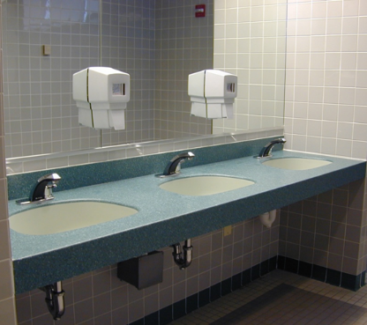
Lavatories and Sinks
Must be forward approach
30” x 48” Clear Floor Space
Pipes must be insulated
Counter surface 34” max
27” knee clearance

Slide 103
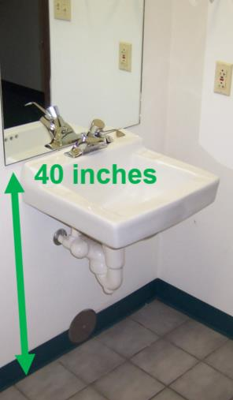
Mirrors
Above Lavatory
    Reflecting Surface shall be 40” max from ground or floor
  Not Above Lavatory
    Reflecting Surface shall be 35” max from ground or floor

Slide 104
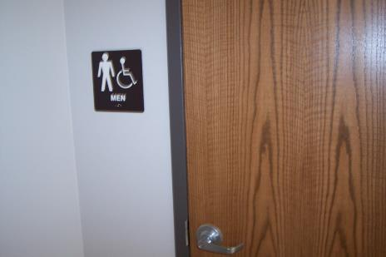
Signage
Tactile Signage mounted on latch side of doors.
Mounted 48”-60” from ground or floor
Clear floor space of 18”x18” beyond arc of the door swing
Tactile signage requires Braille
Characters should color contrast to backing

Slide 105
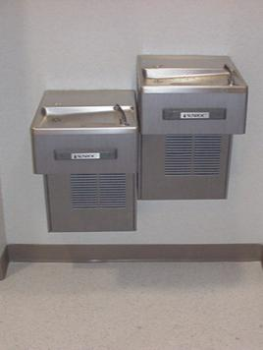
Drinking Fountains
Where provided on an exterior site or floor,
2 required: wheelchair accessible & standing access
alternative: single unit with
dual access (e.g., “hi-lo” units)
multiple installations:
50% of each type

Slide 106
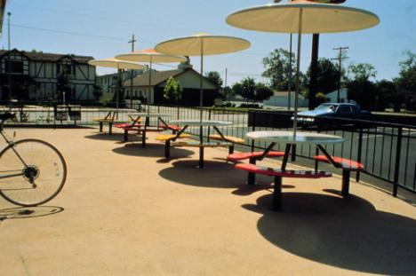
Dining & Work Surfaces
Access to at least 5%, not fewer than 1

Slide 107

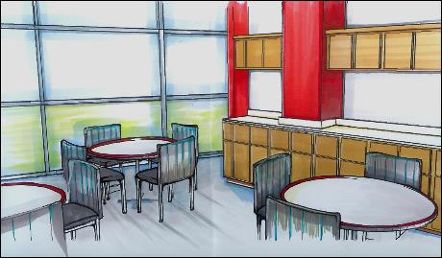
Storage Facilities
Where storage is provided at least one type of each shall be accessible

Slide 108
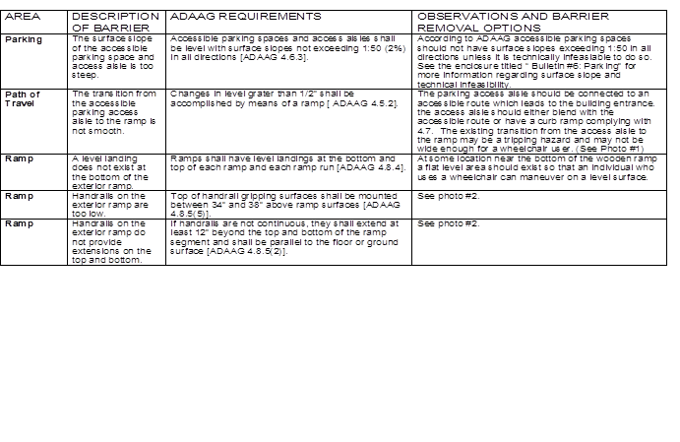
SURVEY REPORT

Slide 109
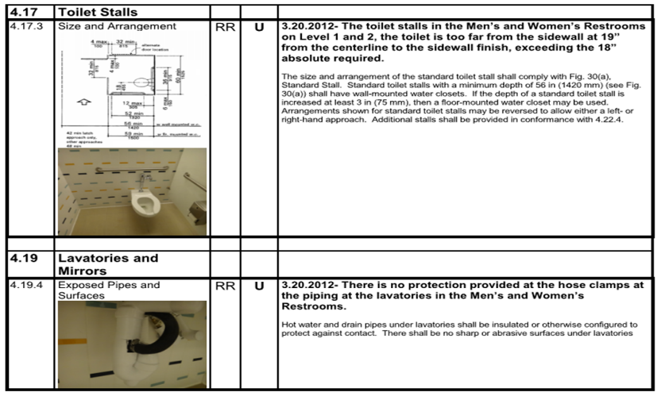
SURVEY REPORT (2)

Slide 110

Survey Report (3)

Slide 111

Survey Report (4)

Slide 112
Transition Plan Approaches
Follow each program or
Assess the facilities and how they are used, then document where accessible programs can be offered
Assess both at once, then consider together

Slide 113
Developing the Plan
Involve your community
Keep regulatory changes in mind
Develop usable databases
Establish priorities and limits
Get public comment
Post on the web

Slide 114
Prioritization
Physical barriers found when performing access surveys need to be assessed to determine a time table for removing them

Slide 115
Prioritization Factors
Where are the users
Use frequency
Danger/Safety Concerns
Severity/Work Around
Cost- Quantitative
Cost- Efficiency

Slide 116
Just Do It
The entire purpose of a self-evaluation/transition plan is to:
    Improve your community
    Eliminate discrimination
    Comply with the ADA
A Plan Requires Action
    Execution, Execution, Execution

Slide 117
Transition Plan Examples
Google Search “ADA transition plan sample”
http://www.cmap.illinois.gov/ada-transition-plans
http://plan.abag.ca.gov/members/rmm/dbp/ADA%20%20Draft%20ADA%20Transition%20Plan%20Sample%20(CIty%20of%20Emeryville).pdf

Slide 118
QUESTIONS
Thank You

