Slide 1
Accessible
Pedestrian Facilities in the
Public Right-of-Way
Presented By: Michael Edwards
Great Plains ADA Center
Slides by
Melissa Anderson, PE
Principal, Melissa A Anderson, LLC

Slide 2
Agenda
Legal Obligations for Accessibility
Organization of Proposed Rule
Pedestrian Access Route
Pedestrian Circulation Area
Curb Ramps and Blended Transitions
Pedestrian Crossings
Transit Stops and Shelters
Parking
Questions and Answers

Slide 3
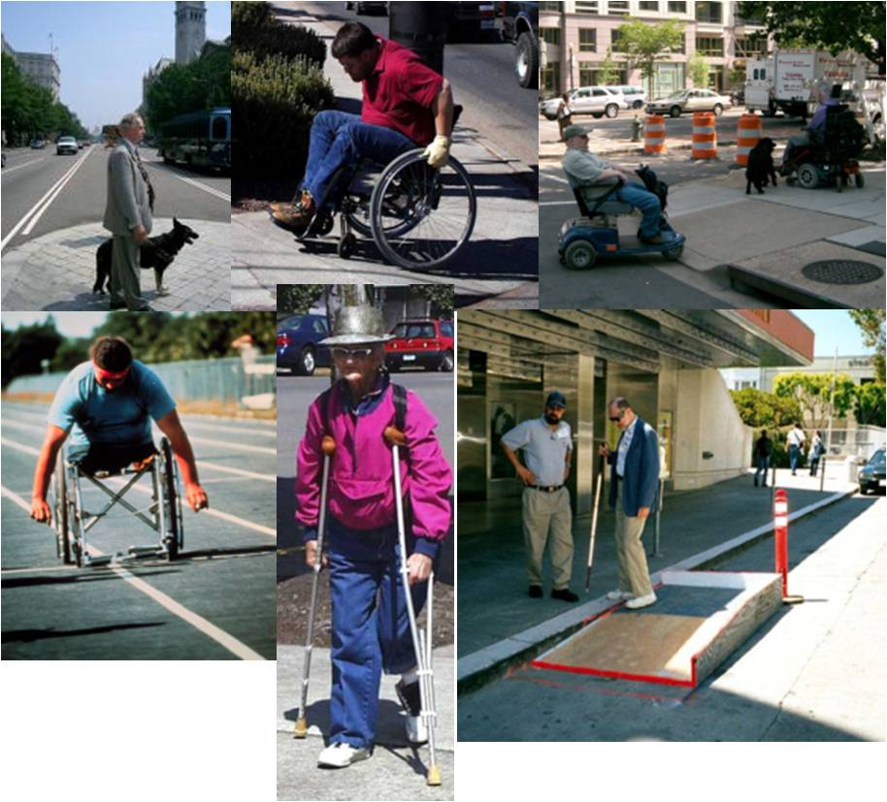
Pedestrians with Disabilities
Pictures of persons with different disabilities

Slide 4
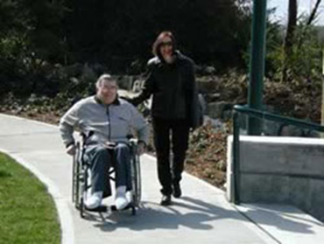
Discrimination is Illegal
1973 Rehabilitation Act, Section 504
- Prohibits discrimination based on disabilities
- Applies to programs and activities receiving Federal funds
1990 Americans with Disabilities Act
  - Civil Rights Law
  - Prohibits discrimination in the provision
  of facilities, services, and programs
- Title II applies to State and Local Governments

Slide 5
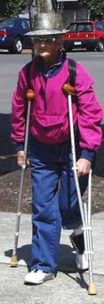
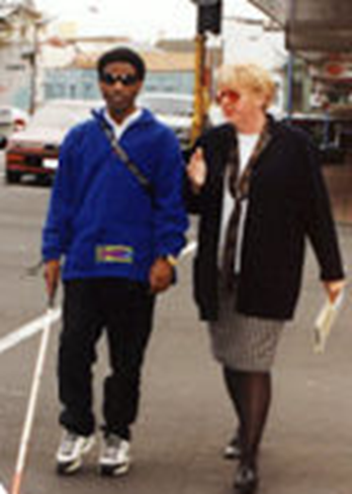
United States Access Board
Established in 1973 as an independent Federal agency
Tasked with developing design criteria and providing technical assistance to ensure access
  Built environment – buildings, sites and infrastructure
  Transportation vehicles
  Telecommunication and information technology
Adoption and enforcement responsibilities belong to other
agencies
  Department of Justice
  Department of Transportation
  and others
The Access Board is responsible for enforcing the Architectural Barriers Act in facilities built
with Federal funds
5

Slide 6
Standards vs. Guidelines
Guidelines are developed by the Access Board but must be adopted by another responsible agency to become enforceable standards.
Current enforceable standard is ADAAG or 2010 ADA Standards
FHWA Memo 1/23/06
  - PROWAG – “recommended best practices, and can be considered the state of the practice that could be followed for areas not fully addressed by the present ADAAG standards”
6

Slide 7

Rulemaking Update
Final Rule Draft approval by the Access Board
Review by the Office of Management and Budget
Publication in the Federal Register
Adoption by the Department of Justice and Department of Transportation
Graphic image of a rocker switch
Graphic image showing high and low unobstructed reach range (48 inches above finished floor or ground maximum and 15 inches above finished floor or ground minimum)

Slide 8

Supplemental Notice of Proposed Rulemaking
Accessibility Guidelines for Pedestrian Facilities in the Public Right-of-Way; Shared Use Paths (2013)
Incorporates shared use path
guidelines into the 2011 proposed PROWAG (web only)
  R1 Application and Administration
  R2 Scoping Requirements
  R3 Technical Requirements
  R4 Supplementary Technical Requirements

Slide 9


What can State and Local Agencies do in the meantime?
Policy
Standards
Education
Enforcement at local level

Slide 10
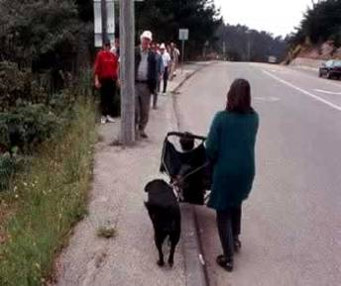
Accessibility Obligations
New construction is required to be accessible
Alterations to existing facilities must be accessible to the maximum extent practicable
            Existing facilities that have not been altered can not deny access to persons with disabilities
10

Slide 11
Technical Requirements
Pedestrian Access Route

Slide 12
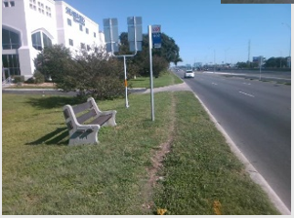
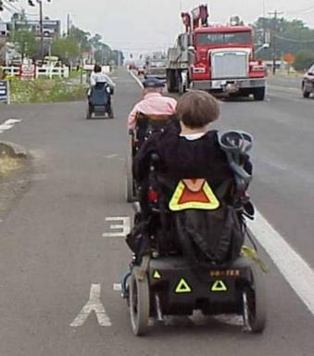
Sidewalks - Who needs them?
If sidewalks are provided, then they are required to be accessible to and usable by a person with a disability.
12

Slide 13
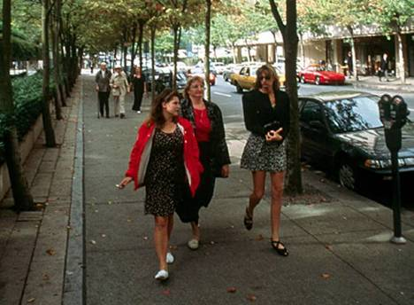
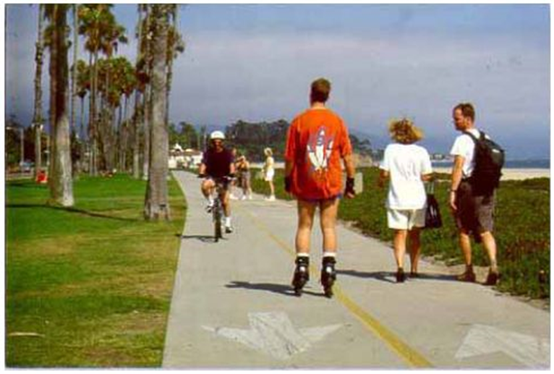
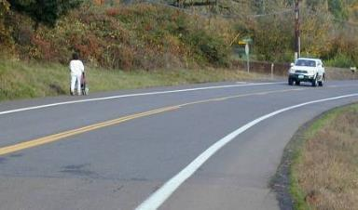
Types of Pedestrian Facilities
Pedestrian Access Routes
Shared-use Paths
(peds and bikes)
Sidewalks
(pedestrians only)
Shoulders
13

Slide 14
Pedestrian Access Route Basics
Contains 48” min pedestrian access route, (36” min accessible route);
2% maximum cross slope;
Surface is firm, stable and slip resistant;
Minimize level changes;
No protruding objects within circulation path;
Clear floor space at entrances, pedestrian pushbuttons, and other pedestrian features (drinking fountains, telephones, ATMs…)
14

Slide 15
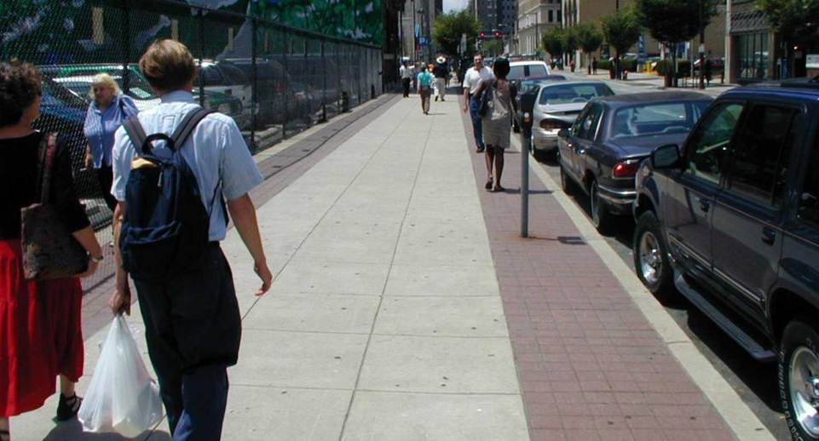
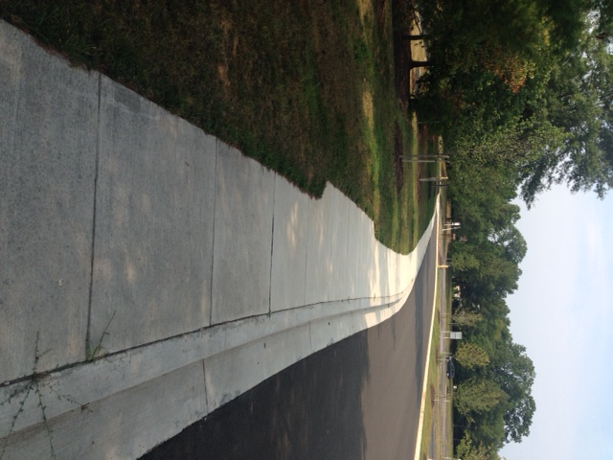
Pedestrian Access Route Clear Width
4 ft min
Photo of wide side walk with 2 brick strips with an arrow in the middle depicting the four foot requirement
4 ft min clear width exclusive of the curb with a 5 ft passing space every 200 ft max

Slide 16
Shared Use Path Width
Width determined by use and not accessibility
16

Slide 17
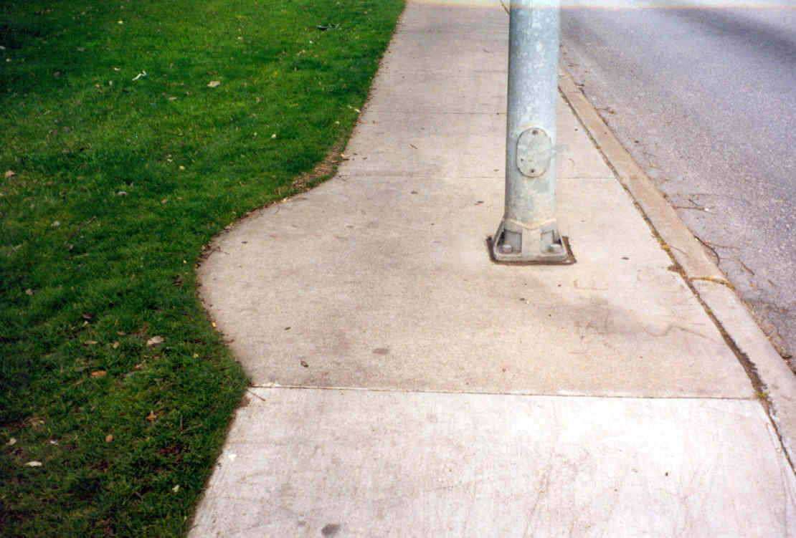
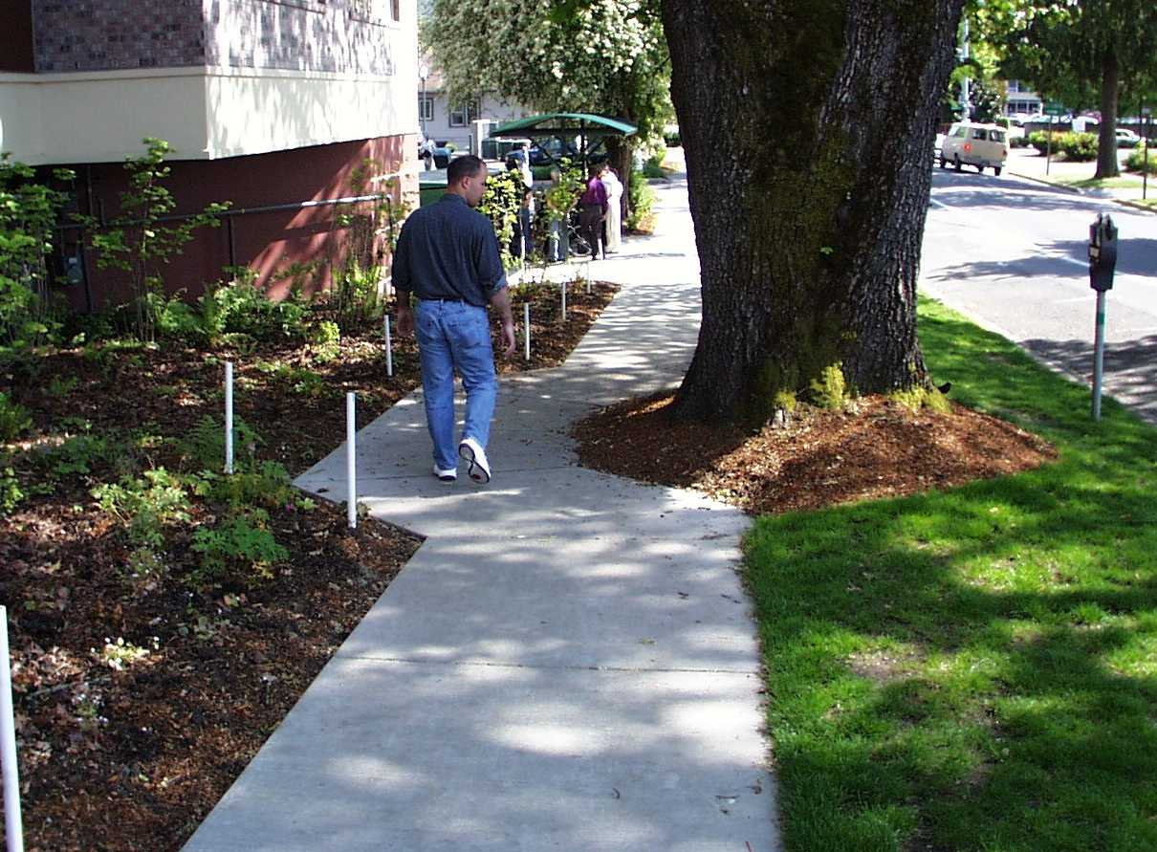
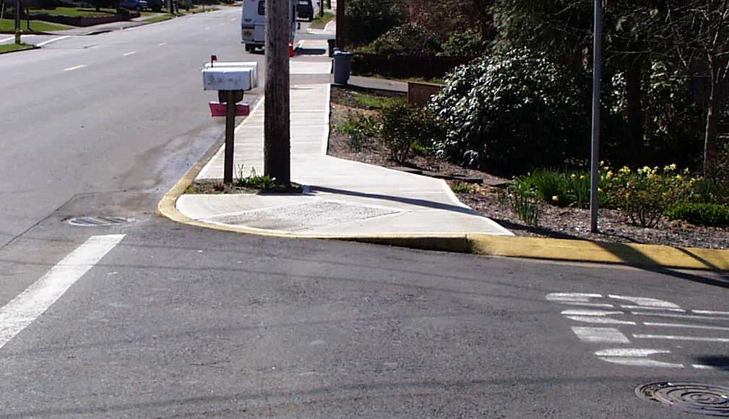
Clear Width
48” min clear width continues around all obstructions
17

Slide 18
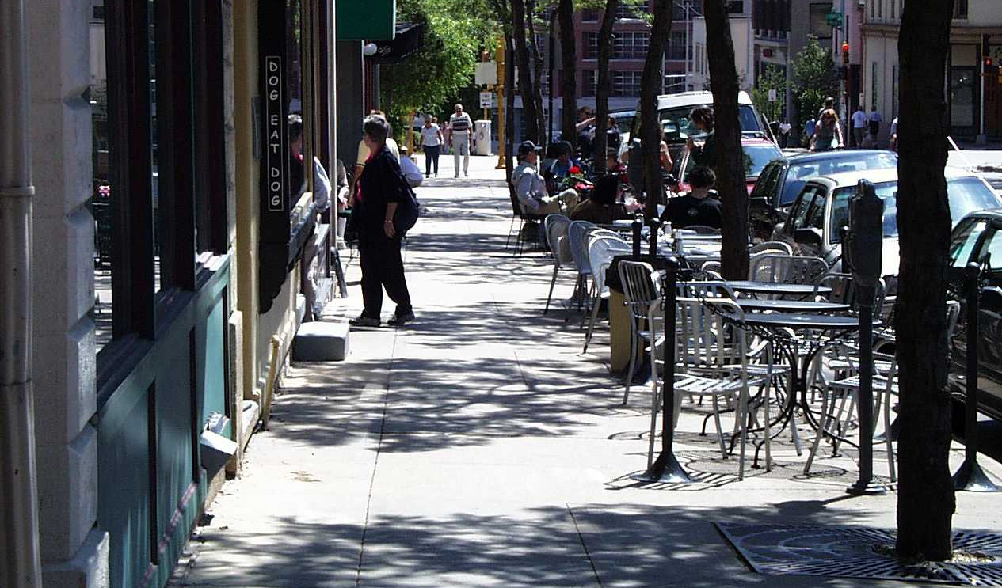
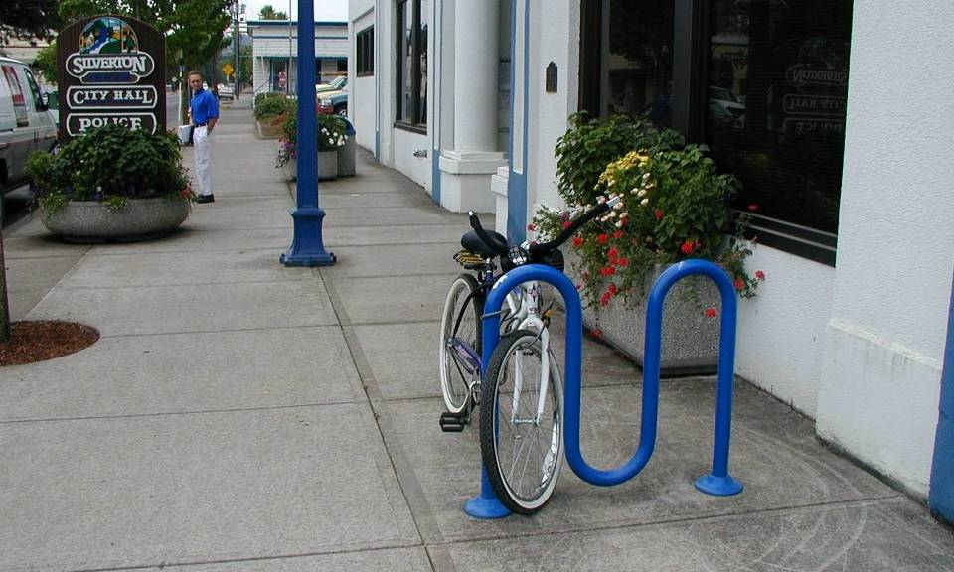
Which one meets the requirements??
18

Slide 19
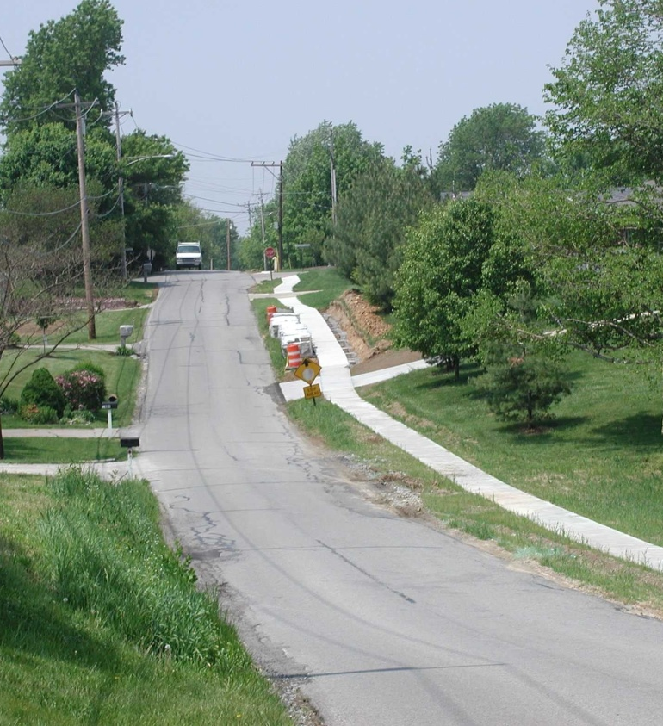
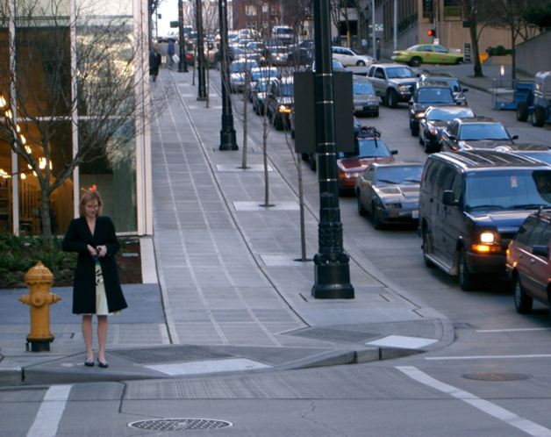
Pedestrian Access Route Running Slope
R302.5.1 Within Street or Highway Right-of-Way. Except as provided in R302.5.3, the grade of pedestrian access routes shall not exceed the general grade established for the adjacent street or highway.
R302.5.2 Not Within Street or Highway Right-of-Way. The grade of pedestrian access routes shall be 5 percent maximum.
R302.5.3 Within Pedestrian Street Crossings. The
grade of pedestrian access routes shall be
5 percent maximum.
Photo of steep urban roadway with a curb attached sidewalk

Slide 20
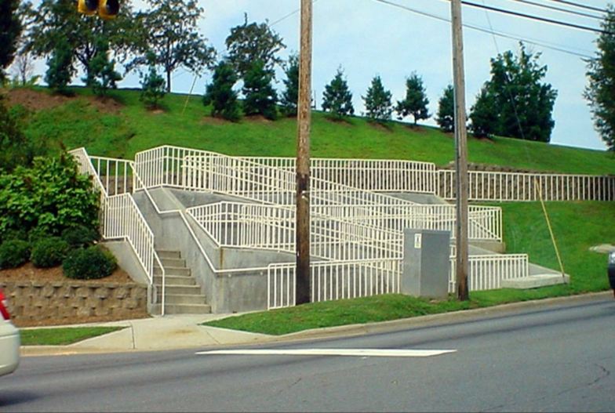
Accessible Route Running Slope
What it looks like if the building guidelines are applied
Photo of sidewalk with a switchback ramp on it with handrails

Slide 21
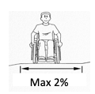
Pedestrian Access Route Cross Slope
0% best for wheelchair users
Some slope needed for drainage
Max cross slope 2%
Graphic showing cross slope of 2% in the middle with steeper cross slope on each side

Slide 22
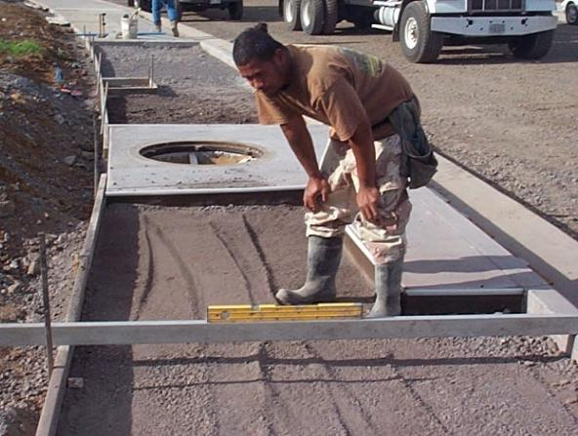
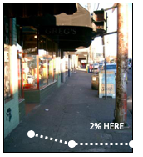
Pedestrian Access Route Cross Slope
Photo of construction worker measuring cross slope with a level before concrete is poured
Photo of an existing sidewalk with the middle at a 2% cross slope; with a steeper cross slope near the building
2% HERE
Cross Slope: 2% maximum
Construction tolerances?
Design accordingly – 1.5%?

Slide 23
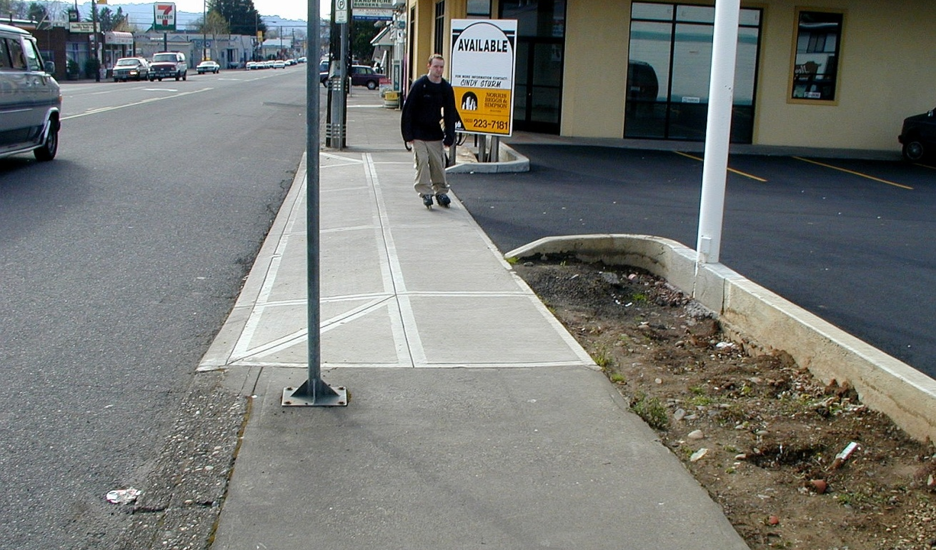
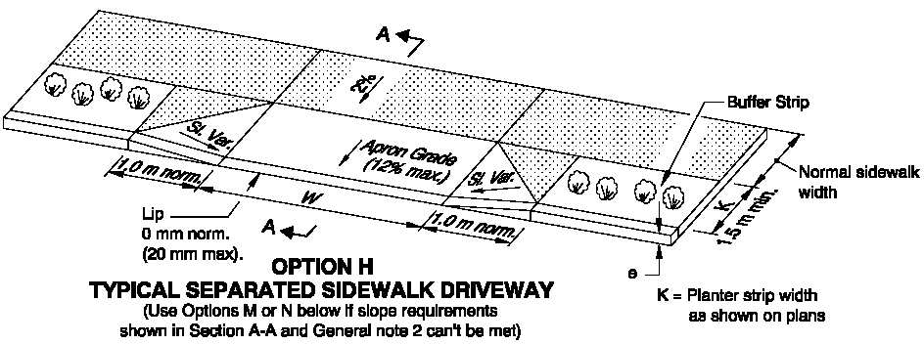
Driveways
Design a continuous usable cross slope
23

Slide 24
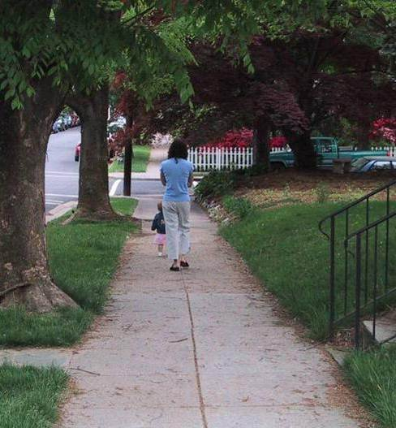
Pedestrian Access Route Surface
Surfaces: stable, firm and slip resistant
Photo of sidewalk with grass on each side and large trees

Slide 25
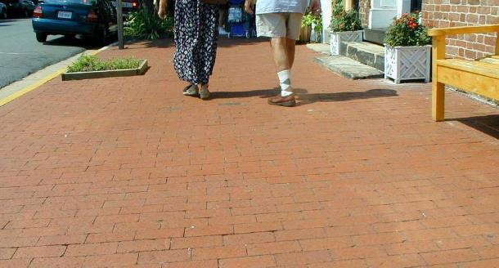
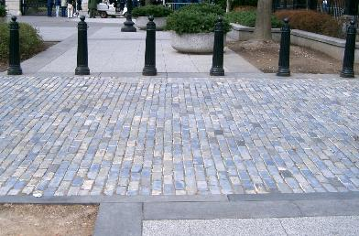

Surfaces
Properly installed, and well maintained bricks and pavers can work. Beveled edges are a problem for rollability.
25

Slide 26
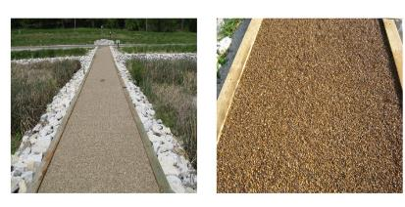

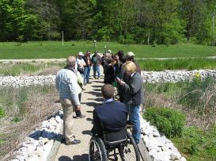
Surfaces
Shared Use Paths and Trails
loose gavel surface material
National Trails Surface Study
Loose surface materials:
Generally need special treatment (e.g., binders, consolidates, compaction, and grid forms)
Frequent maintenance
NCA’s website - http://www.ncaonline.org/

Slide 27
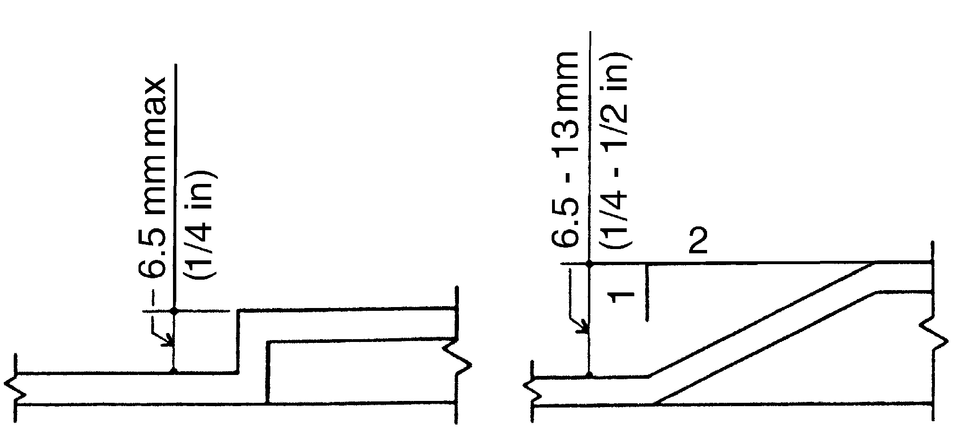
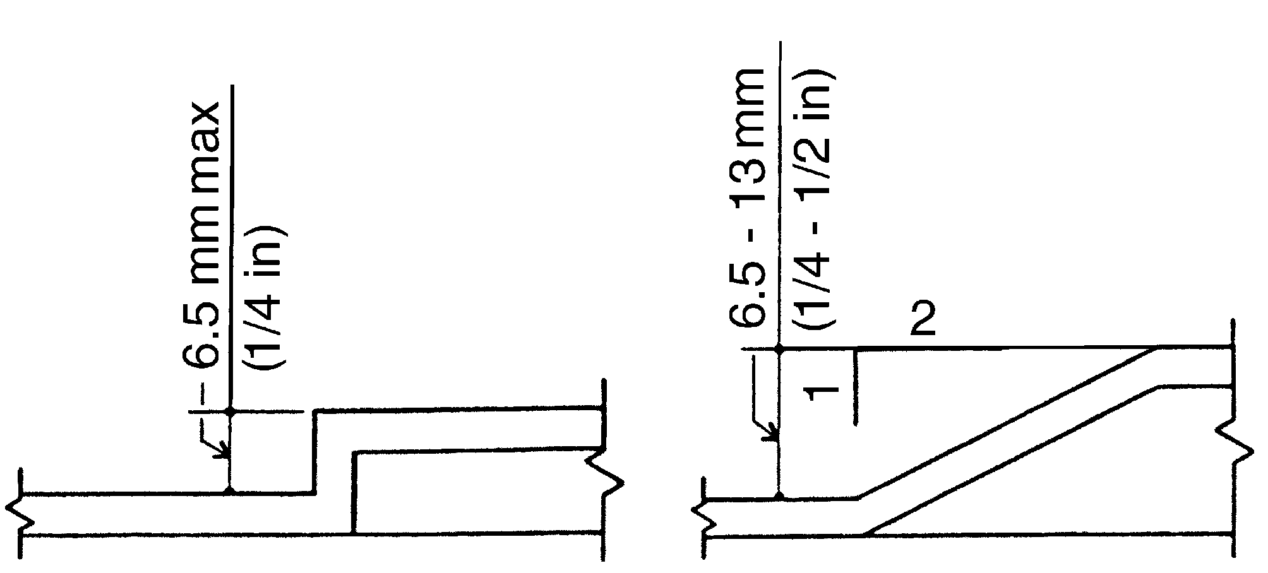
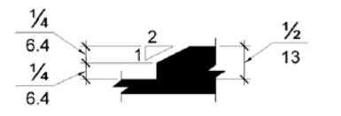
Surface Discontinuity
* Grade breaks must be flush – curb ramps!
27

Slide 28
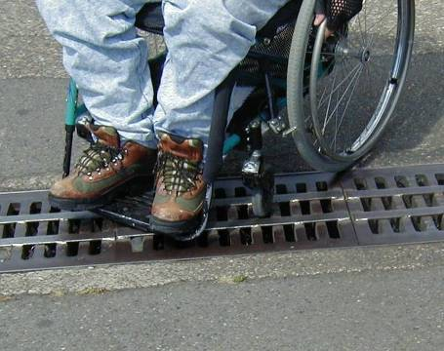
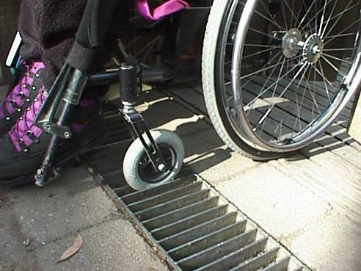
Pedestrian Access Route Surface
Photo of wheelchair caster stuck in elongated openings of grate
Photo of wheelchair caster going over a grate that has bars welded on it to make the openings smaller
Horizontal openings no more than ½ inch in the direction of travel

Slide 29
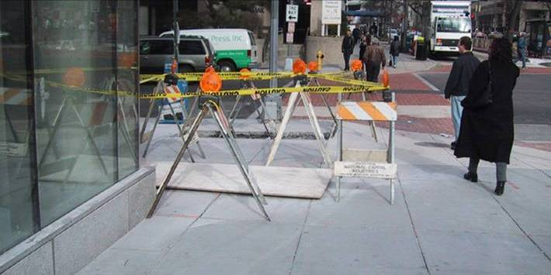
Temporary Pedestrian Access Routes
Must have access to temporary events and facilities –
  Farmers markets
  Food trucks, etc.
Maintenance of accessible
facilities -
  Construction detours

Slide 30
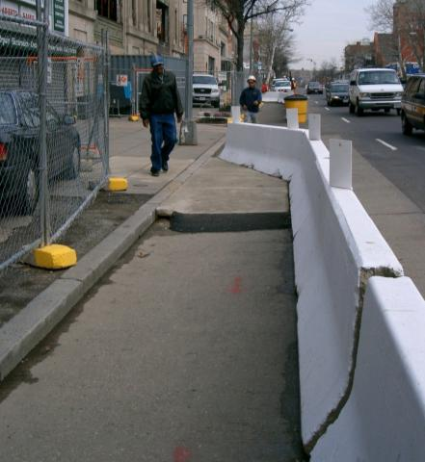
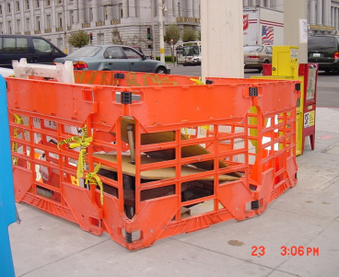
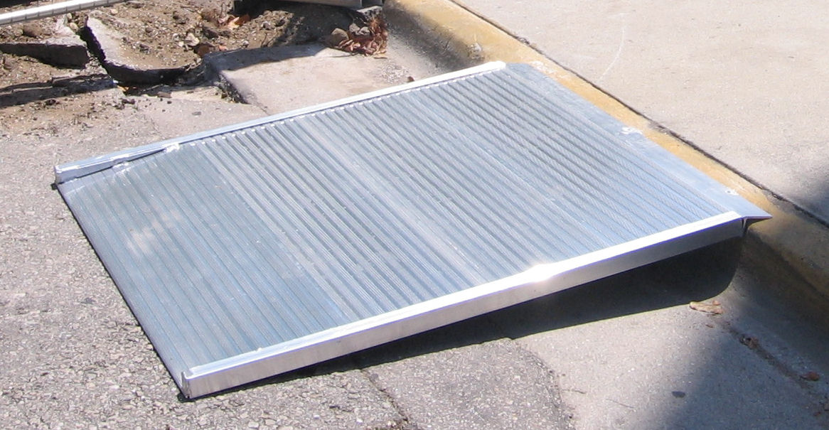
Alternate Pedestrian Access Route in Work Zones
Image of pedestrian routes around construction
Image of cane detectable barrier around construction materials on a sidewalk

Slide 31
Curb Ramps and Blended Transitions

Slide 32
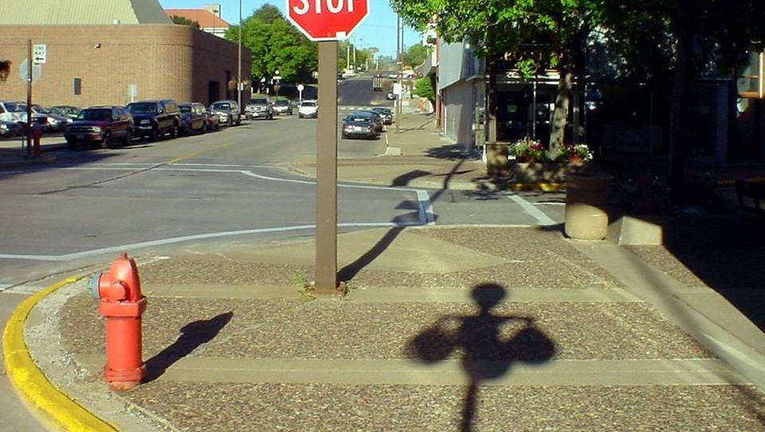
Curb Ramps & Blended Transitions
One ramp for each street crossing
Image of an intersection with diagonal curb ramps showing the preferred straight line of pedestrians and the zigzag route required by using the curb ramps provided
Notes:
32

Slide 33
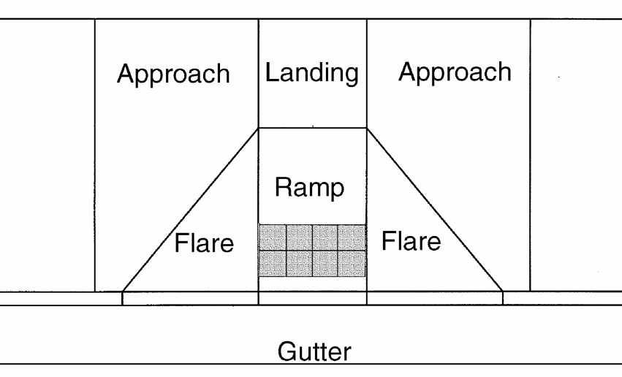
Anatomy of a Curb Ramp
Turning Space
Running slope - 8% max*
Cross slope - 2% max*
Counter slope - 13% max
Flare slope - 10% max
Turning space*
Perpendicular grade breaks
Flush transitions
The ‘cookie cutter’ curb ramp

Slide 34
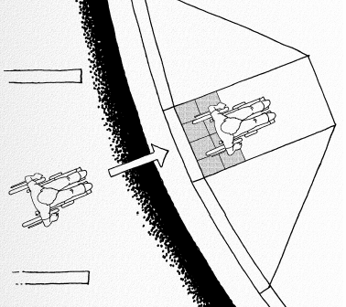
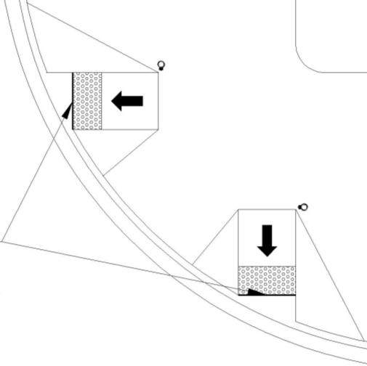
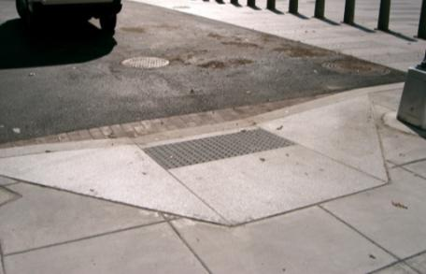
Perpendicular Curb Ramps
Image of perpendicular curb ramp
Graphic of 2 perpendicular curb ramps at a corner
Ramp slope perpendicular to the curb or street crossing

Slide 35
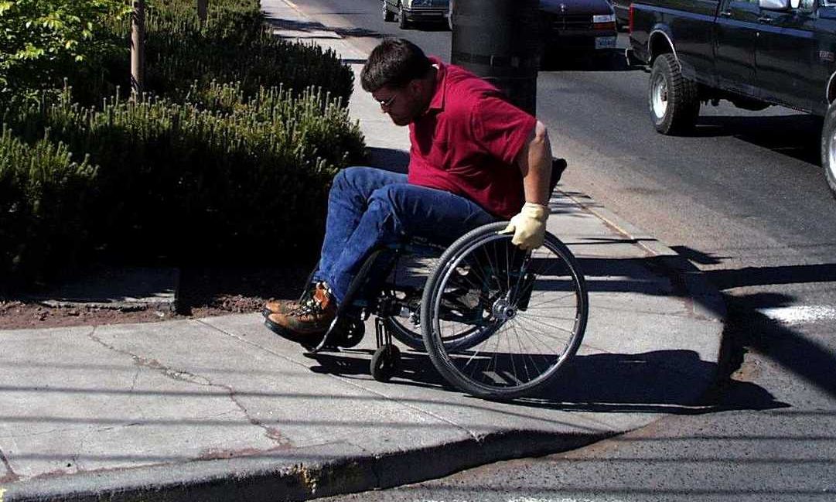
Perpendicular Curb Ramps
Turning space is required at the top of curb ramps for changing direction (4’ x 4’ min, 4’x 5’ if constrained)

Slide 36
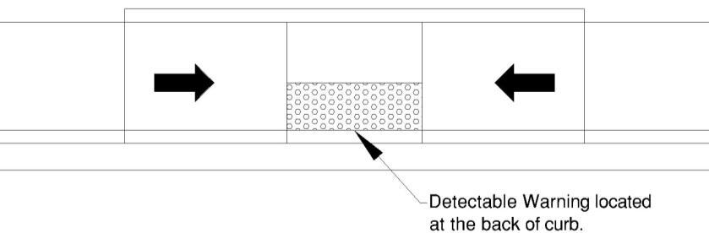
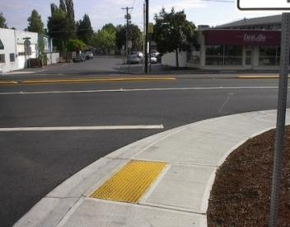
Parallel Curb Ramps
Image of parallel curb ramp
Graphic of parallel curb ramp
Ramp slope parallel to the curb or street crossing

Slide 37
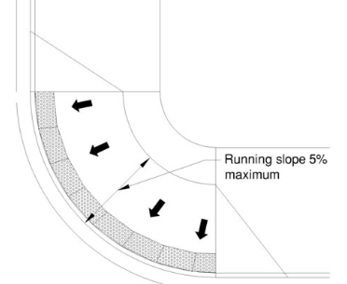
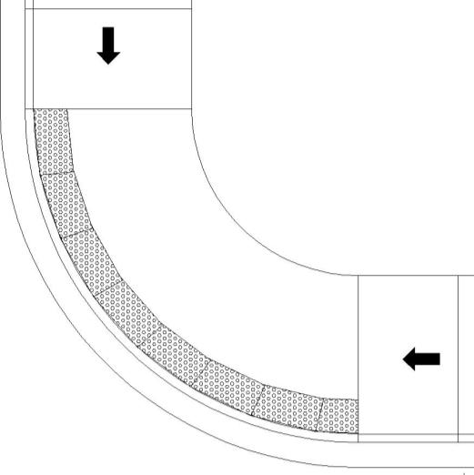
Blended Transitions
2% cross slope to travel around the corner
Image of blended transition a depressed corner
Graphic of a blended transition
Blended Transition (depressed corner)

Slide 38
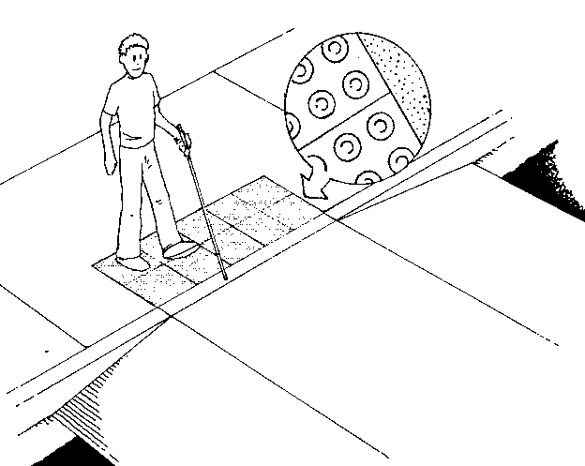

Blended Transitions
Image of a blended transition a raised crossing
Graphic of a blended transition
Blended Transition (raised crossing)

Slide 39


Combination Curb Ramps
Graphic of a combination curb ramp
Image of a combination curb ramp
Combination ramp

Slide 40


Counter
Slope
Counter slope 5% max.
40

Slide 41
Detectable Warning Devices

Slide 42



Detectable Warning Devices
Image of curb ramps with detectable warnings
Image of blended transition with detectable warnings
Image of curb ramp with detectable warnings

Slide 43

Detectable Warning Devices
(FHWA Memo)
Provide warning to the visually impaired that they
are about to enter a hazardous area.
Required at all street crossings, transit boarding platforms - driveways??
Raised domes with in-line or
radial arrangement
24” min. and full width
of curb ramp
Contrasting in color

Slide 44

Detectable Warning Devices
Five images showing detectable warning placements
Detectable warning depth and width? Contrast with surrounding surface required

Slide 45


Detectable Warning Devices
Figure R305.1.2 Dome Spacing: Truncated domes in plan view with a center-to-center spacing of 41 mm (1.6 in) min and 61 mm (2.4 in) max, and a base-to-base spacing of 17 mm (0.65 in) min, measured between the most adjacent domes
Figure R305.1.1 Dome Size: Truncated dome in elevation shown with a base diameter of 23 mm (0.9 in) min to 36 mm (1.4 in) max, a top diameter 50% to 65% of the base diameter, and a height of 5 mm (0.2 in)
Due to their distinctive design, truncated domes are detectable by cane and underfoot

Slide 46


Detectable Warning Location
DW placement on parallel curb ramp
24”
Place at back of curb on landing
46

Slide 47

Detectable Warning Location
A photo of a pedestrian refuge island with detectable warnings
Pedestrian refuge islands

Slide 48
Pedestrian Crossings

Slide 49




Street Crossings
49

Slide 50

Pedestrian Street Crossings
Image of a pedestrian using a walker crossing a street
Image of several able bodied people crowded onto the curb ramp waiting to cross
Continuation of PAR
Walking speed – 3.5 ft/sec

Slide 51
Street Crossings
5% max running slope, or street crown (PROWAG only);
2% max cross slope on curb ramps and crosswalks, exception for some intersections;
Pedestrian walk indicators with non-visual information provided (Accessible Pedestrian Signal);
Adequate crossing time (3.5 fps);
Multi-lane roundabouts need some type of pedestrian demand signalization.
51

Slide 52


Crosswalks
MUTCD provides definition of a crosswalk

Slide 53


Pedestrian Crosswalks
Image of a marked crossing
Image of a marked crossing
The guidelines do not tell you when to mark
Or how to mark (look at MUTCD part 3)

Slide 54

Pedestrian Crosswalk Cross Slopes
Image of steep street that has been leveled off at the intersection
Maximum crosswalk cross slope
2% is a general requirement for pedestrian access routes
5% is allowed in a street crossing without stop or yield vehicle control – free flow (PROWAG only)

Slide 55

Pedestrian Crosswalks at Roundabouts
Image of separated sidewalk at roundabout with a pedestrian signal and image of fence around circulatory roadway at roundabout
Pedestrian crossing easily located for way finding at all roundabouts – separation from circulatory lanes
Where pedestrian crossings are multi-lane; pedestrian-activated signals shall be provided

Slide 56
Accessible Pedestrian Signals
(APS)

Slide 57


Accessible Pedestrian Signals – www.apsguide.org
57

Slide 58

Accessible Pedestrian Signals
Button
- Face of button parallel to crosswalk
- Mounted at 42” (48” max used to be 54”)
- Max. 5 lbs pressure needed to activate
Sign
- Adjacent to button – explains
purpose and use
- Must clearly indicate crosswalk
direction
58

Slide 59

Pedestrian Push Button Location
- Accessible route to ramp
and crossing
- Reachable (10 in) from a clear space
- 5 ft from the crosswalk
- 1.5-6 ft from edge of curb
or pavement
- See MUTCD Guidance Fig. 4E-4
59

Slide 60

Pedestrian Push Button Location
A wide sidewalk with the pedestrian pushbutton as far from the crossing as would be possible
Find the pushbutton. Now line up to cross.
Missed your chance? Do it again
60

Slide 61


Accessible Pedestrian Signals
Reach Ranges from Clear Space
Vertical
Max. Reach – 48”
Min. Reach – 15”
(forward & side)
Horizontal
Side reach within 10”
Forward reach – no obstruction or space
61

Slide 62

Accessible Pedestrian Signals
Accessible Features MUTCD 4E.08-4E.13
- Locator tone
- 10 ft. separation, or speech indication
- Speech walk criteria MUTCD 4E.11
- Volume adjusts for ambient noise
- Extended Press Features
- Tactile arrow indicates direction
62

Slide 63



Accessible Pedestrian Signals
Three images of pedestrian push button,2 examples of large pedestrian push button with tactile arrow; and one pedestrian with guide dog using APS;

Slide 64
On-Street Parking

Slide 65

On-Street Parking Scoping
Number of accessible spaces is based upon total on a block perimeter
Scoping Section R214
No van parking required
Image of On-Street parking Permits Zone showing several blocks in downtown Tampa FL

Slide 66


On-Street Parking in a Wide ROW
A 1.5 m (5 ft) wide min access aisle running the full length of parallel parking space and located beyond the face of curb at sidewalk at least 4.3 m (14 ft) wide; aisle served by curb ramp at one end
Image of parallel parking with access aisle
Where the width of the adjacent sidewalk or available right-of-way exceeds 14 ft. an access aisle is required

Slide 67


On-Street Parking in a Narrow ROW
A photo of on-street parking. Several "accessible" spaces include the wheelchair symbol on the payment. Signs are also provided.
In this case, the on-street spaces are located on a narrow sidewalk but not closest to the corner crosswalk. A figure showing on street parking where there are narrow sidewalks. The space is located at the end of the block closest to the curb ramp at the crossing. l
Narrow sidewalks – an access aisle is not required

Slide 68


On-Street Parking
Image of angled parking with an access aisle
Graphic of accessible angled parking
Angled (or perpendicular) on-street parking

Slide 69
On-Street Parking
Displays and Information
A photo of on-street parking. Several "accessible" spaces include the wheelchair symbol on the payment. Signs are also provided.
In this case, the on-street spaces are located on a narrow sidewalk but not closest to the corner crosswalk. A figure showing on street parking where there are narrow sidewalks. The space is located at the end of the block closest to the curb ramp at the crossing. l
Information must be visible from a point 3.3 ft. max above the center of the clear space
Meet operable parts requirements
Located at the head or foot of space

Slide 70
Documents Available Online
www.access-board.gov
SNPRM for Proposed Guidelines for Public Rights-of-Way
Accessible Public Rights-of-Way: Planning and Designing for Alterations
Accessible Sidewalks (DVD, or download)
Detectable Warnings Update
Manufacturers of Detectable Warning Products
As well as many research reports

Slide 71

Questions?
Access Board www.access-board.gov
Email – row@access-board.gov
Technical Assistance – 800-872-2253
Southwest ADA Center
800-949-4232 www.southwestada.org
Melissa Anderson, PE
Anderson@Engineering4Access.com
Image of street sign reading caution pedestrians slippery when wet with a 2 hour parking sign below

